Slide 1
Healthy San Benito County
National Public Health Week 2018

Slide 2

County Health Rankings 2018

Slide 3


Slide 4
Monday:
Behavioral Health
Advocate for and promote well-being

Slide 5
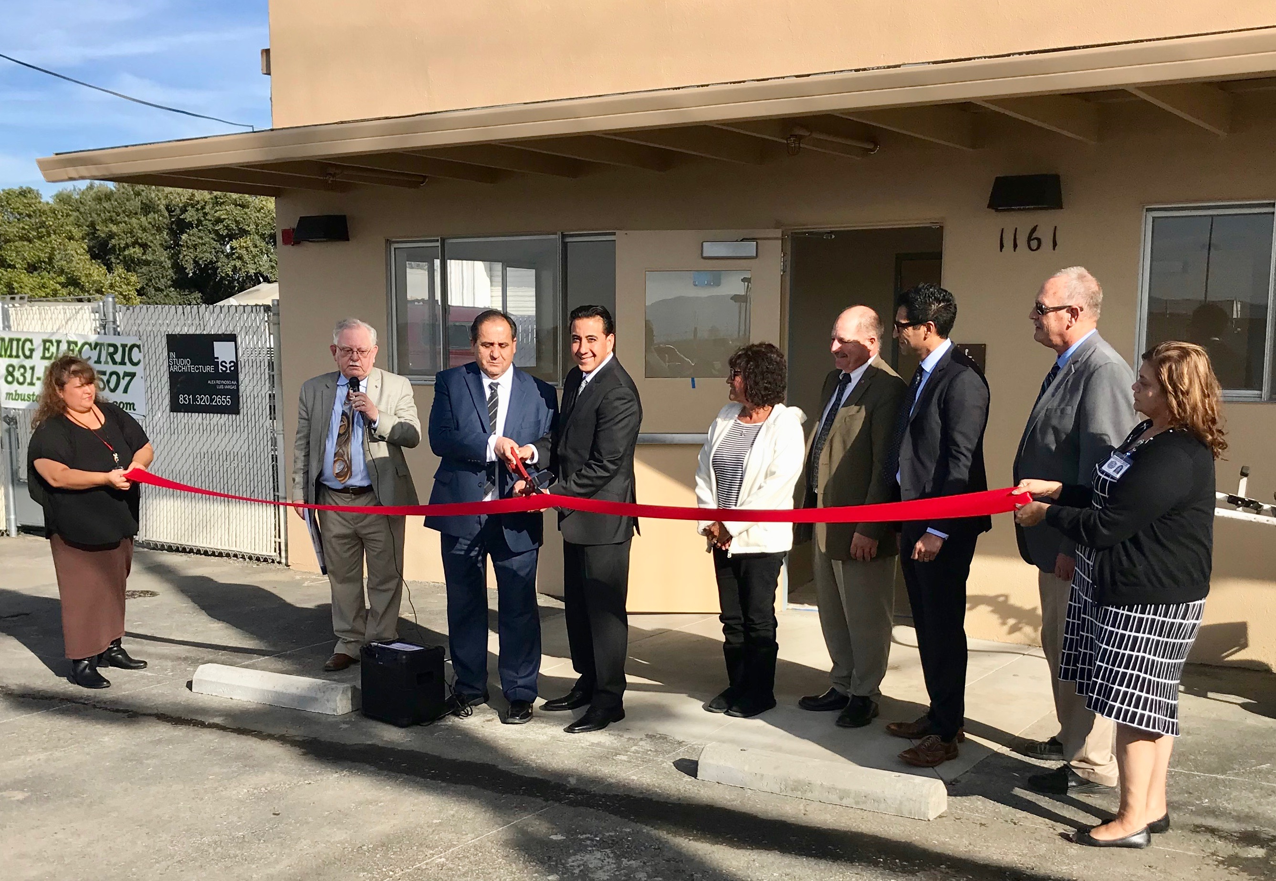
HOME: Whole Person Care

Slide 6

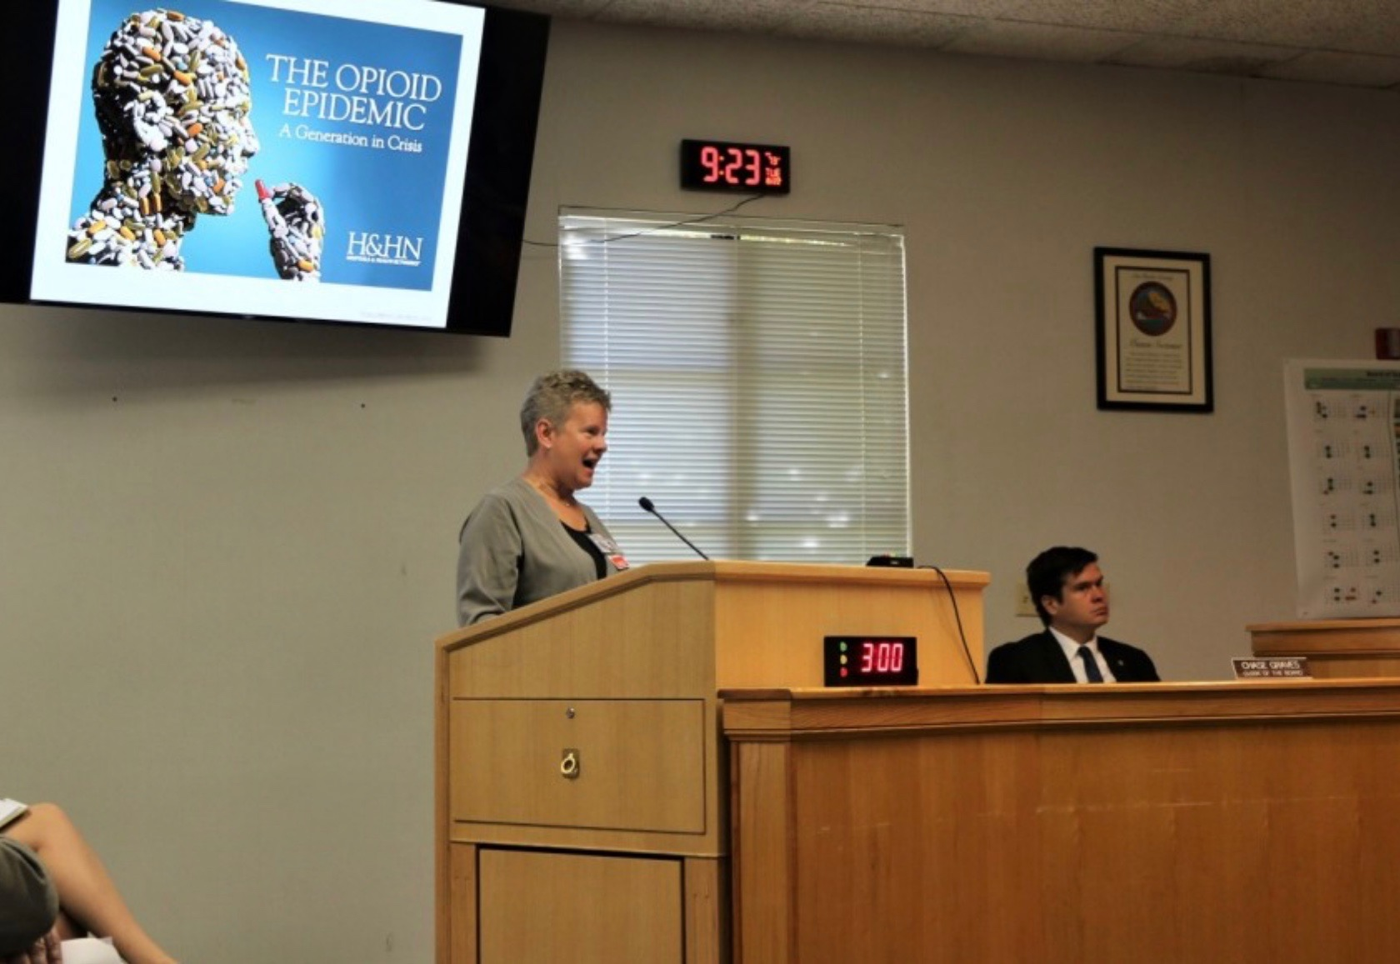
“County exceeds State’s rate of opioid deaths, new task force will target prescriptions and use”
Benito Link headline 8-25-17

Slide 7
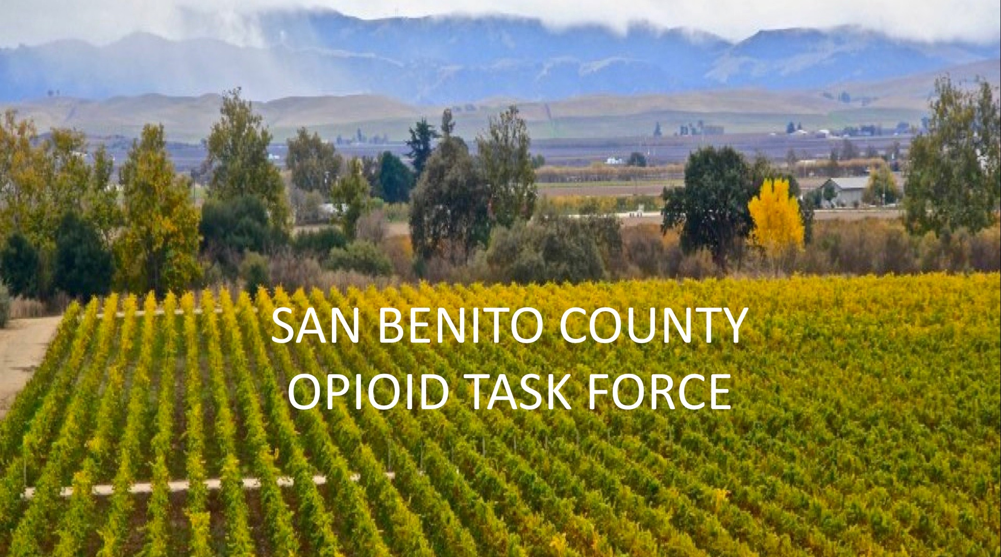

Slide 8
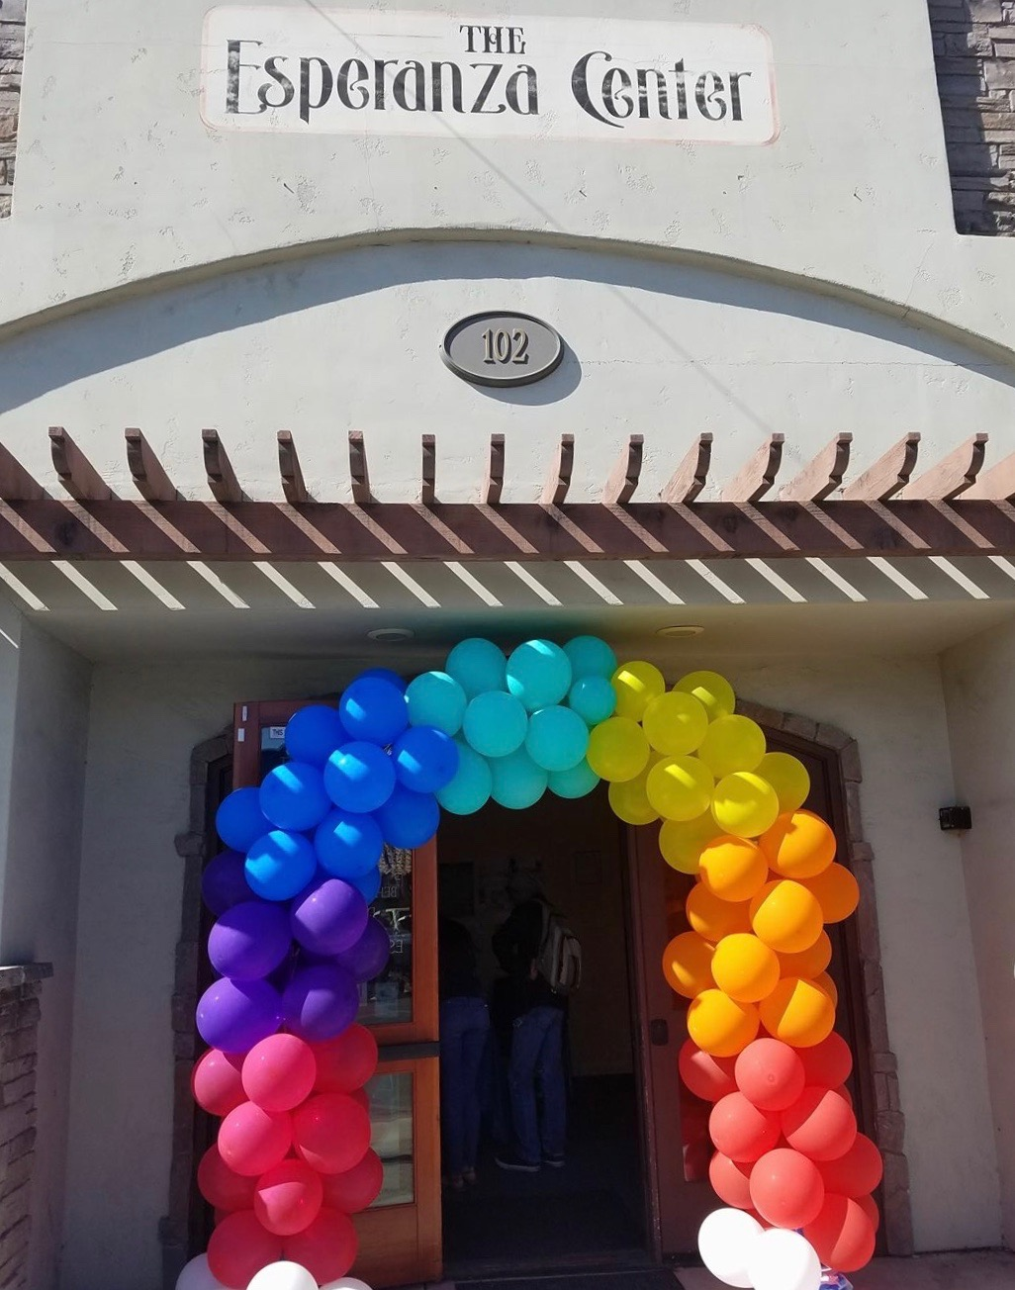
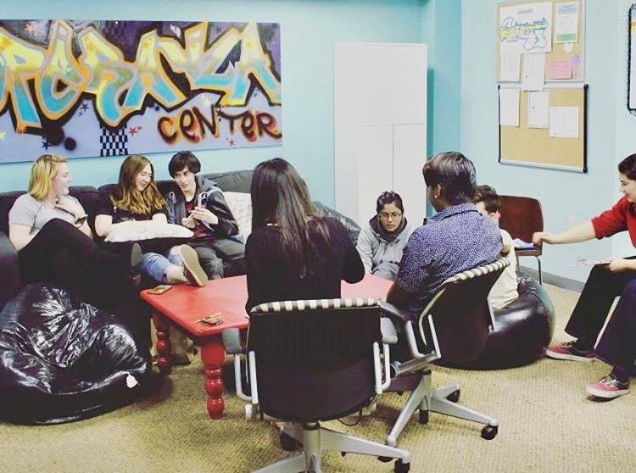
The Esperanza Center

Slide 9

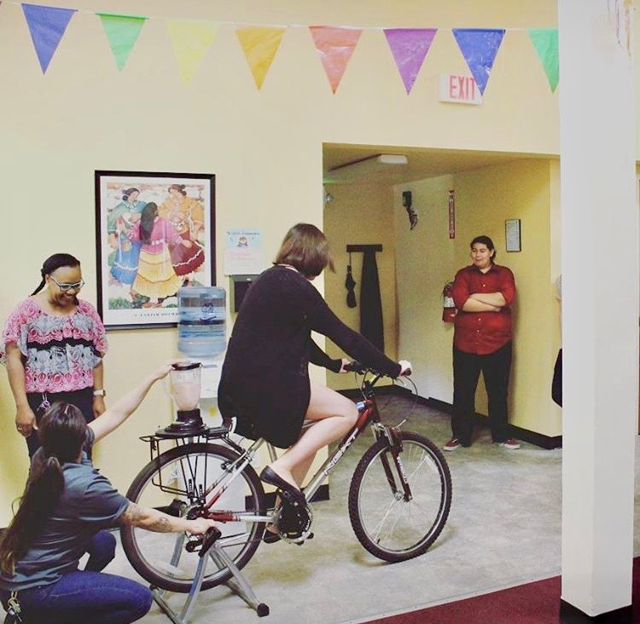
Palentine’s Event

Slide 10
Tuesday:
Communicable Disease
Learn about ways to prevent disease transmission

Slide 11
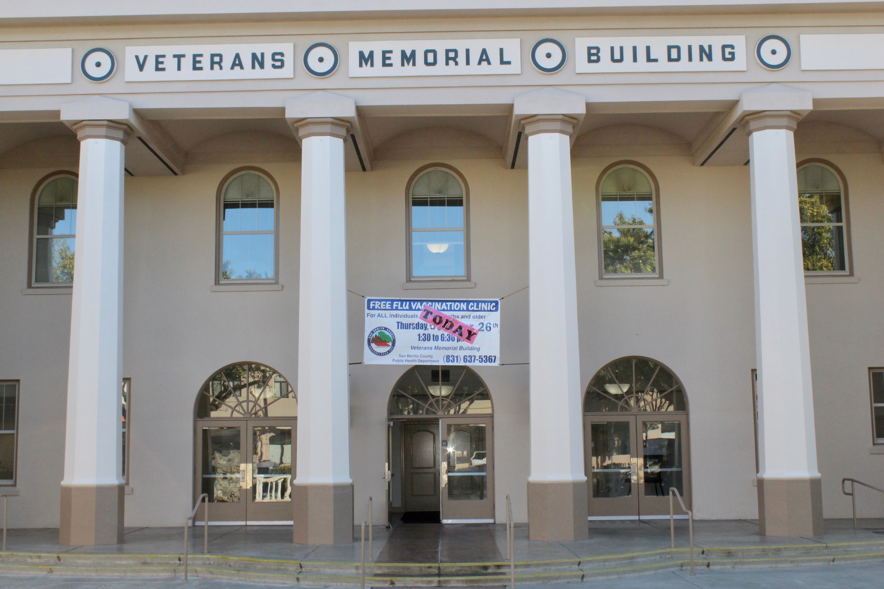

Slide 12
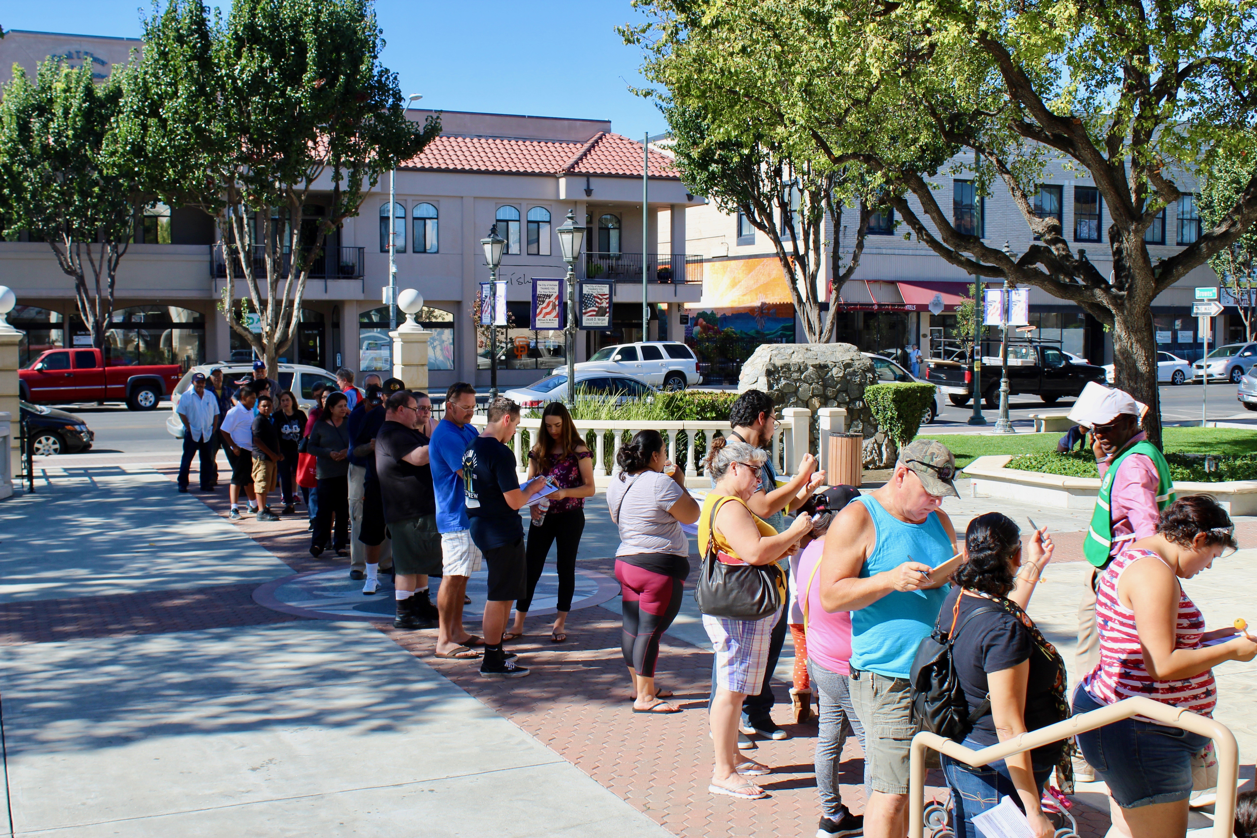

Slide 13
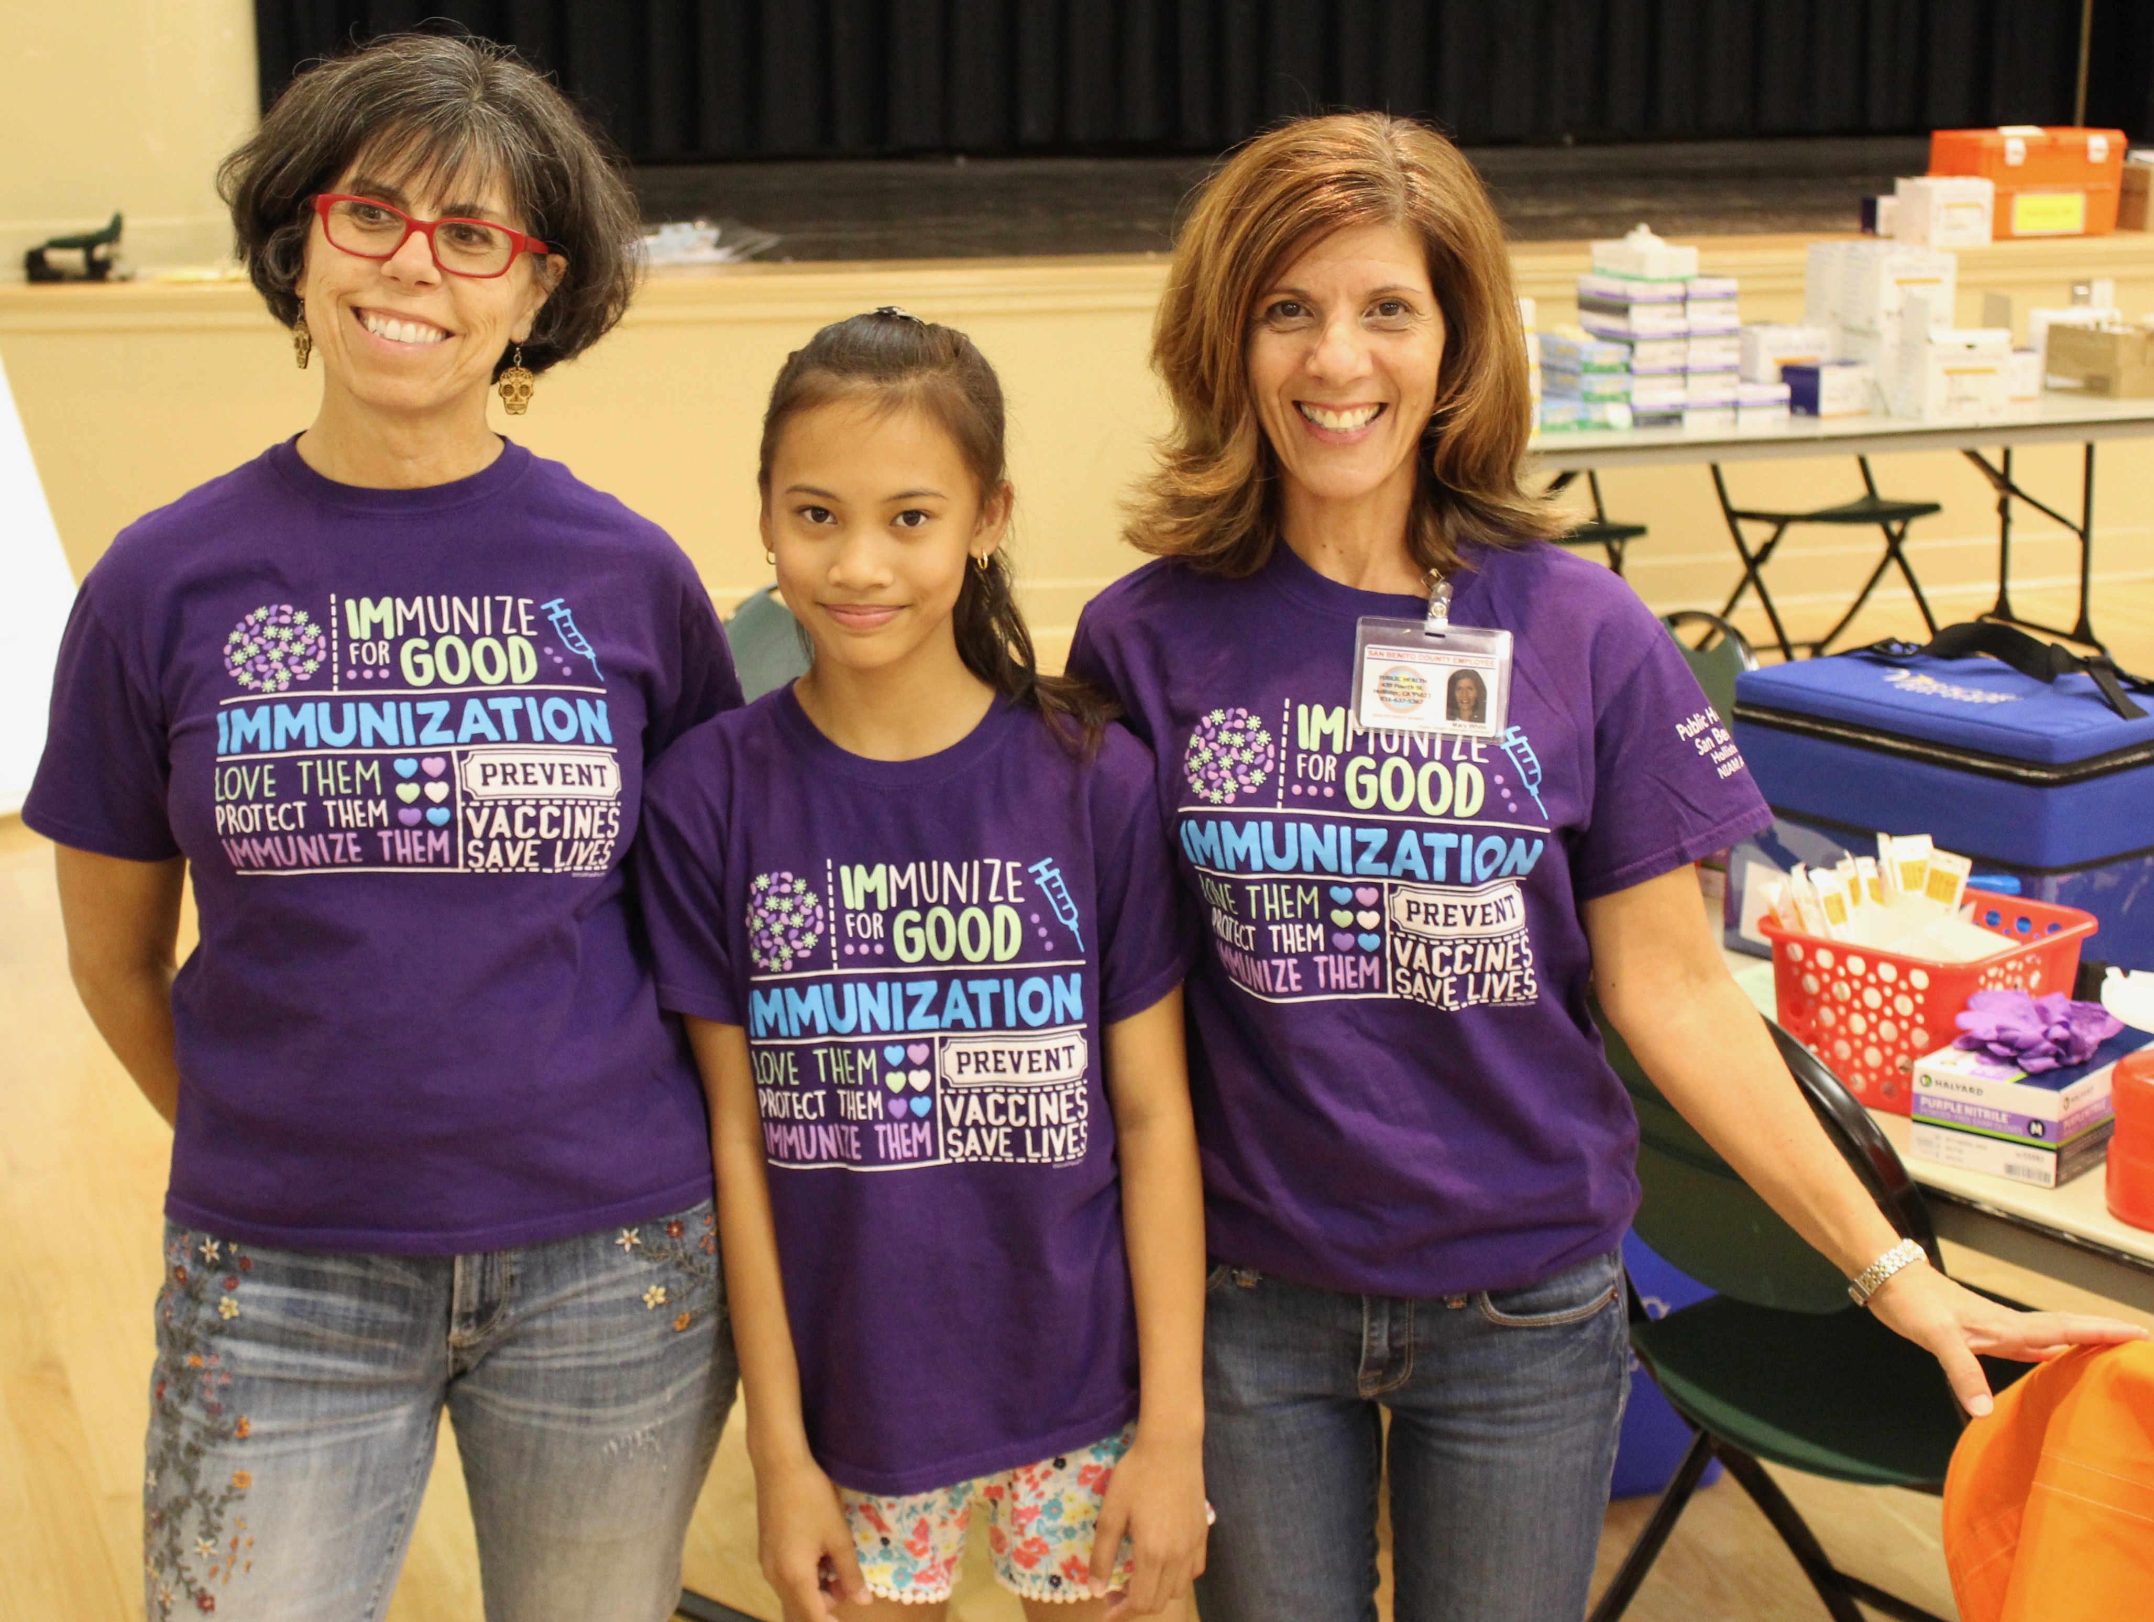

Slide 14
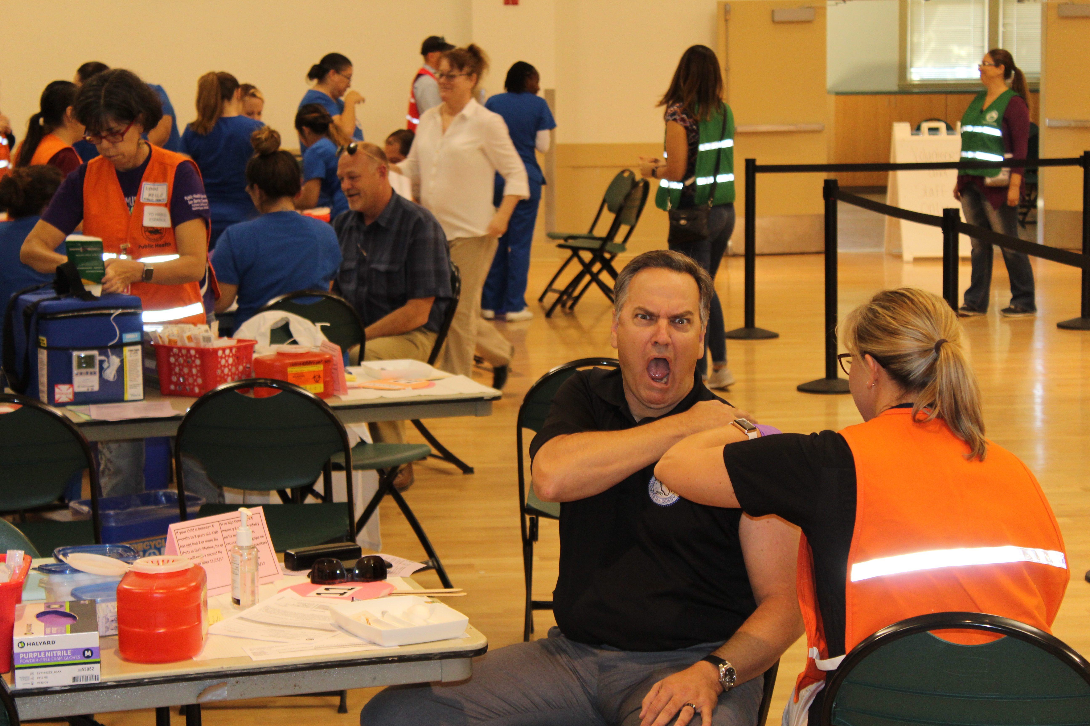

Slide 15
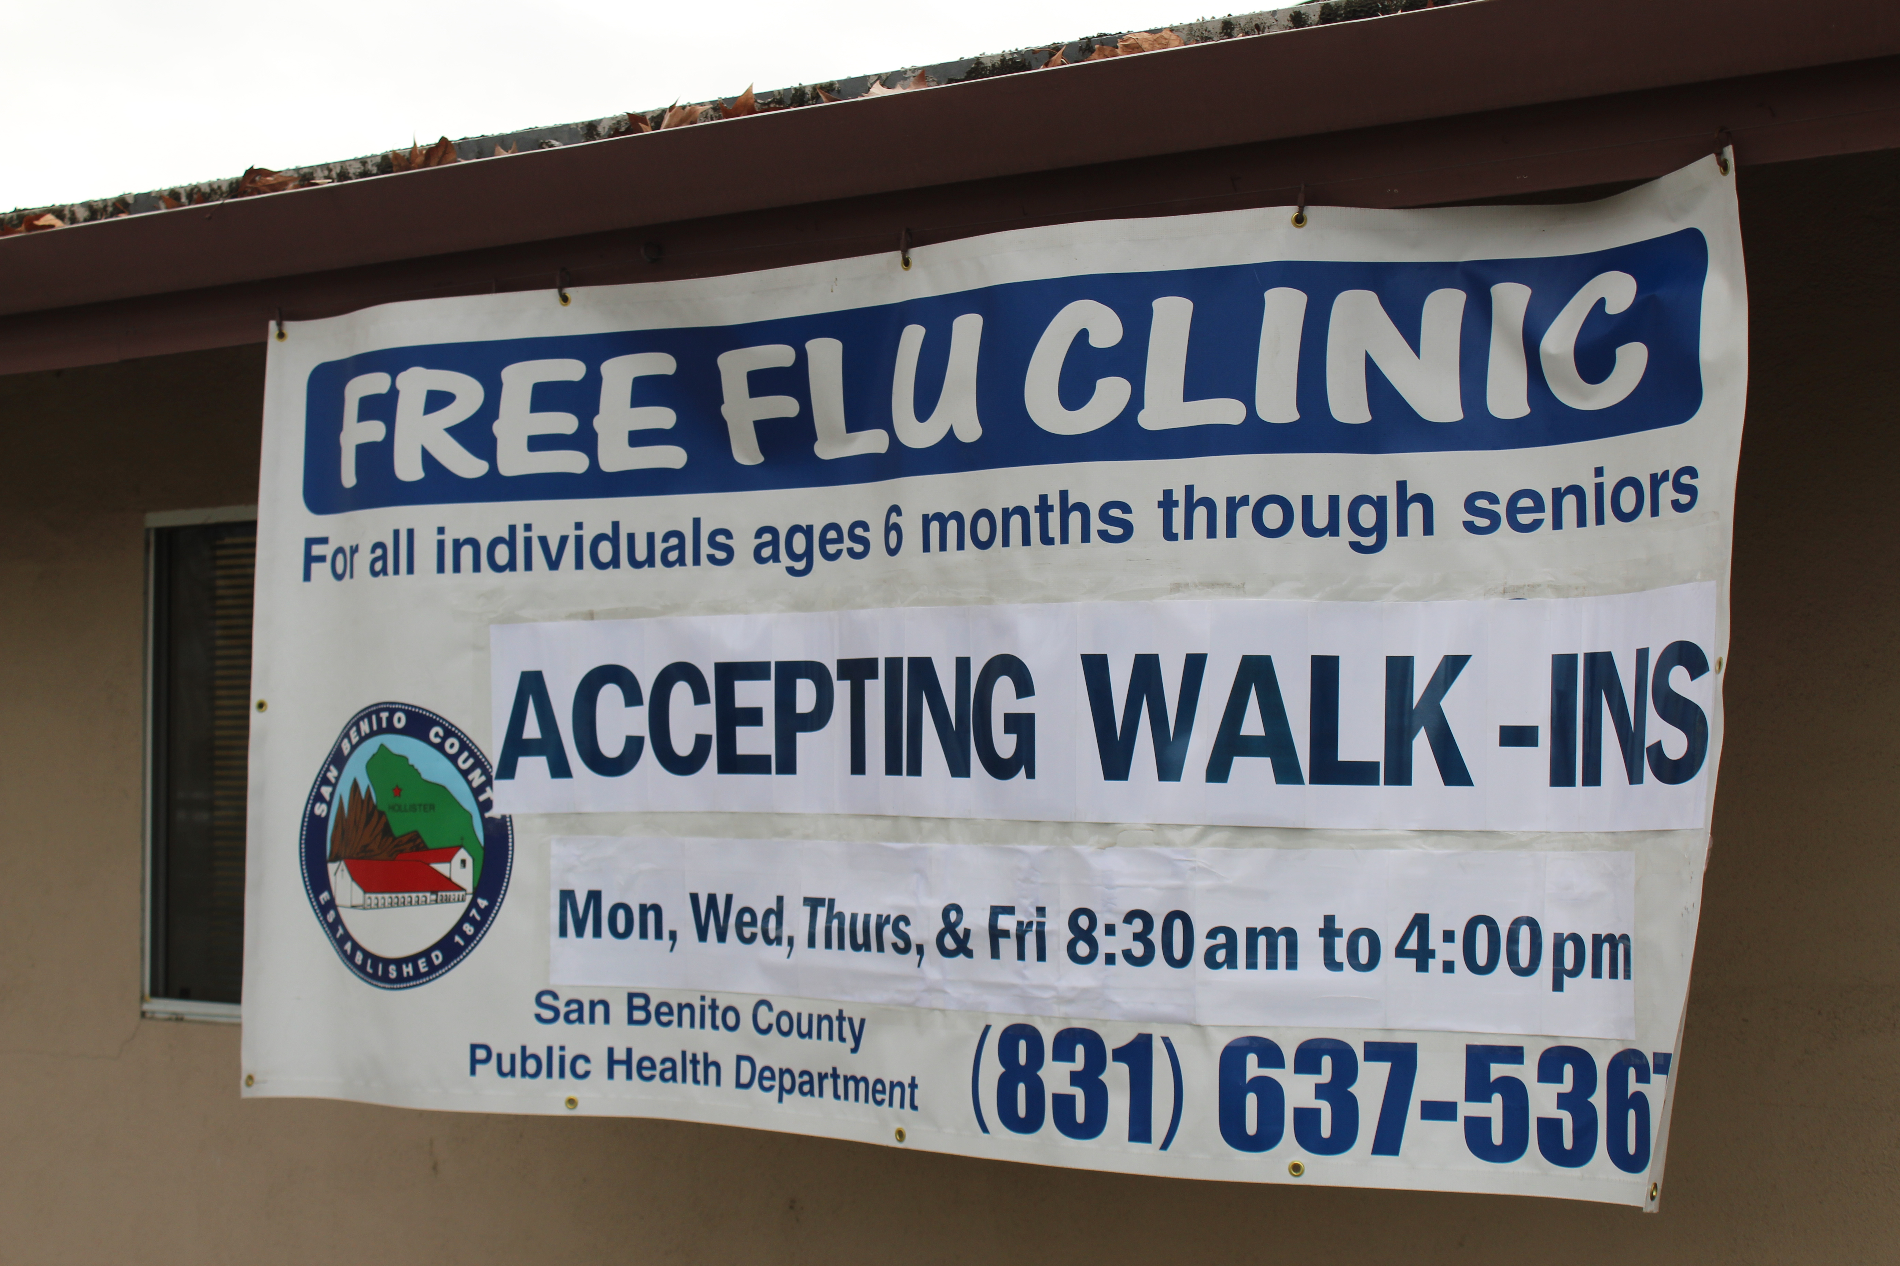

Slide 16
Wednesday:
Environmental Health
Help to protect and maintain a healthy planet

Slide 17
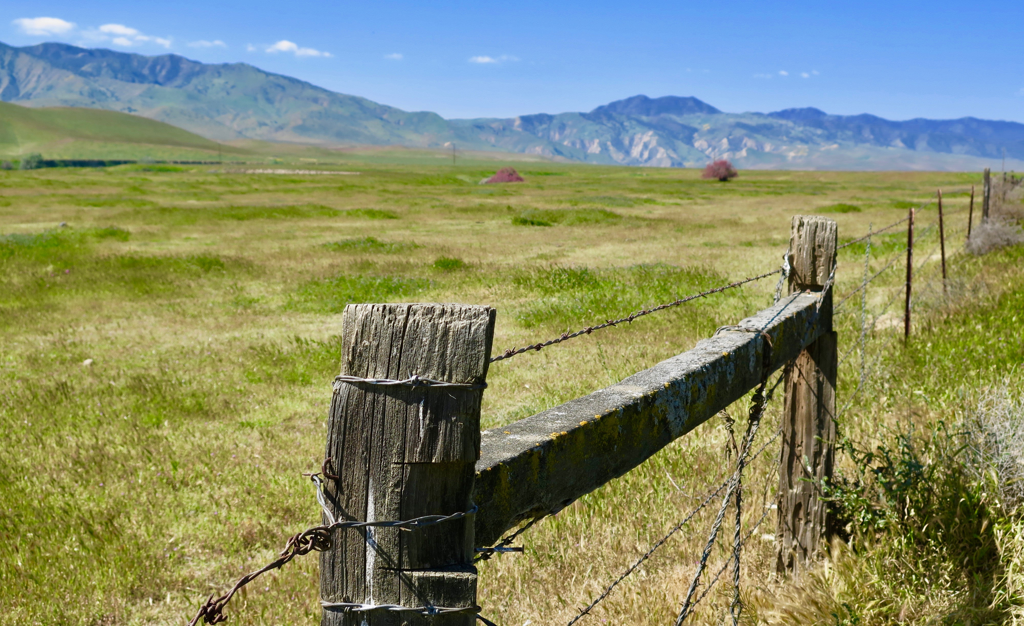

Slide 18
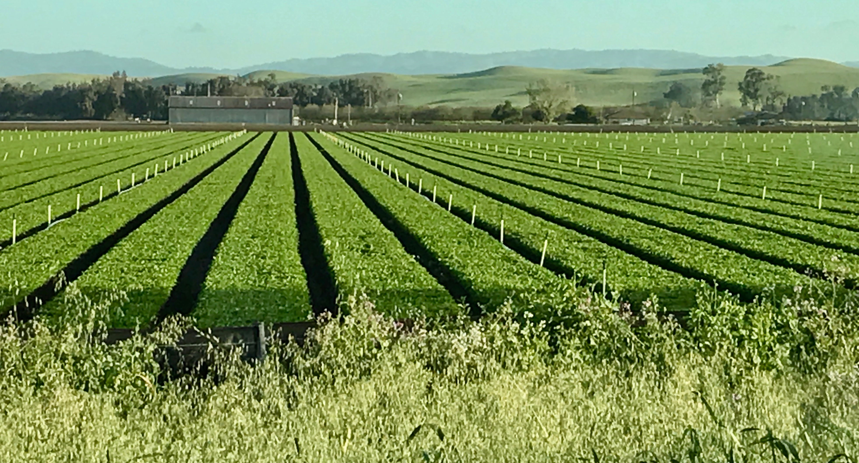

Slide 19
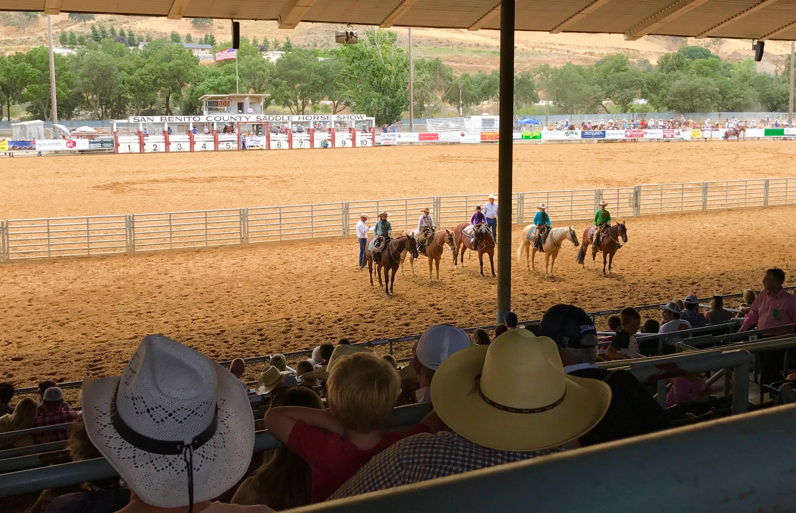

Slide 20
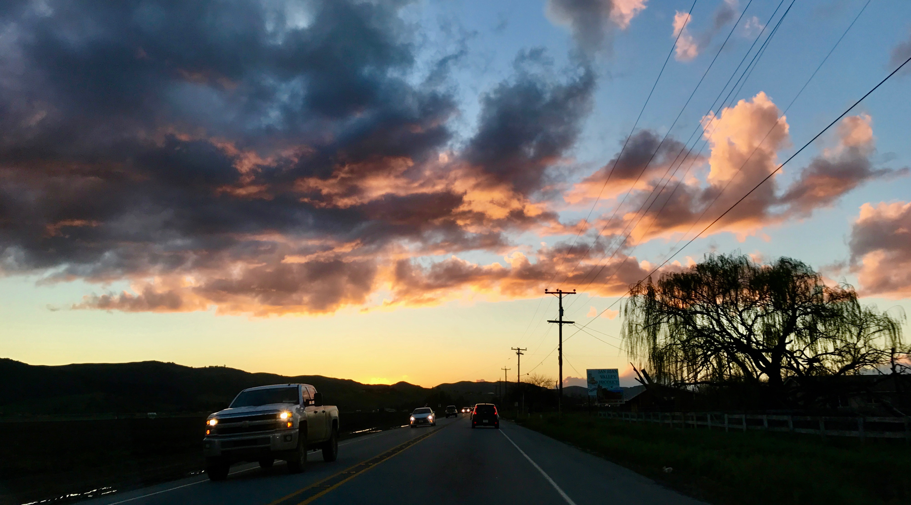

Slide 21
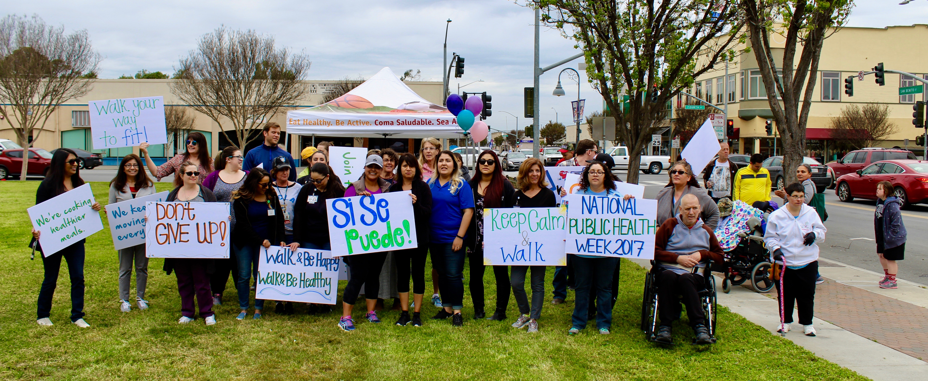
Walk for Wellness

Slide 22
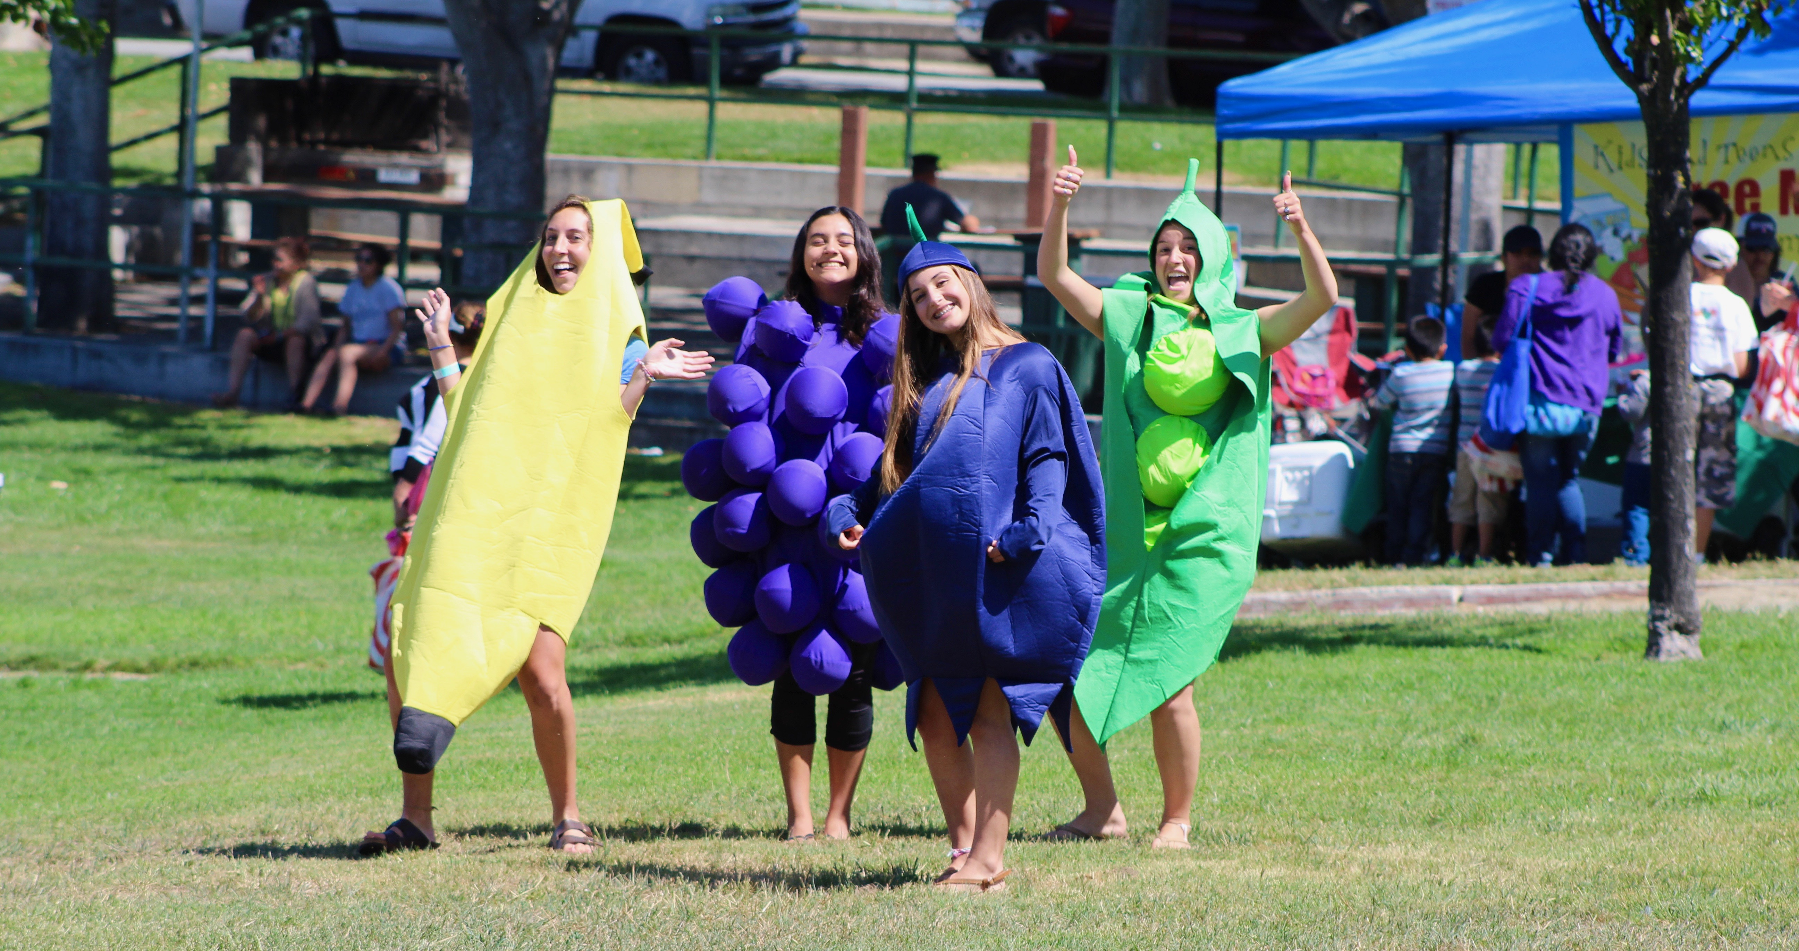
Kids at the Park

Slide 23
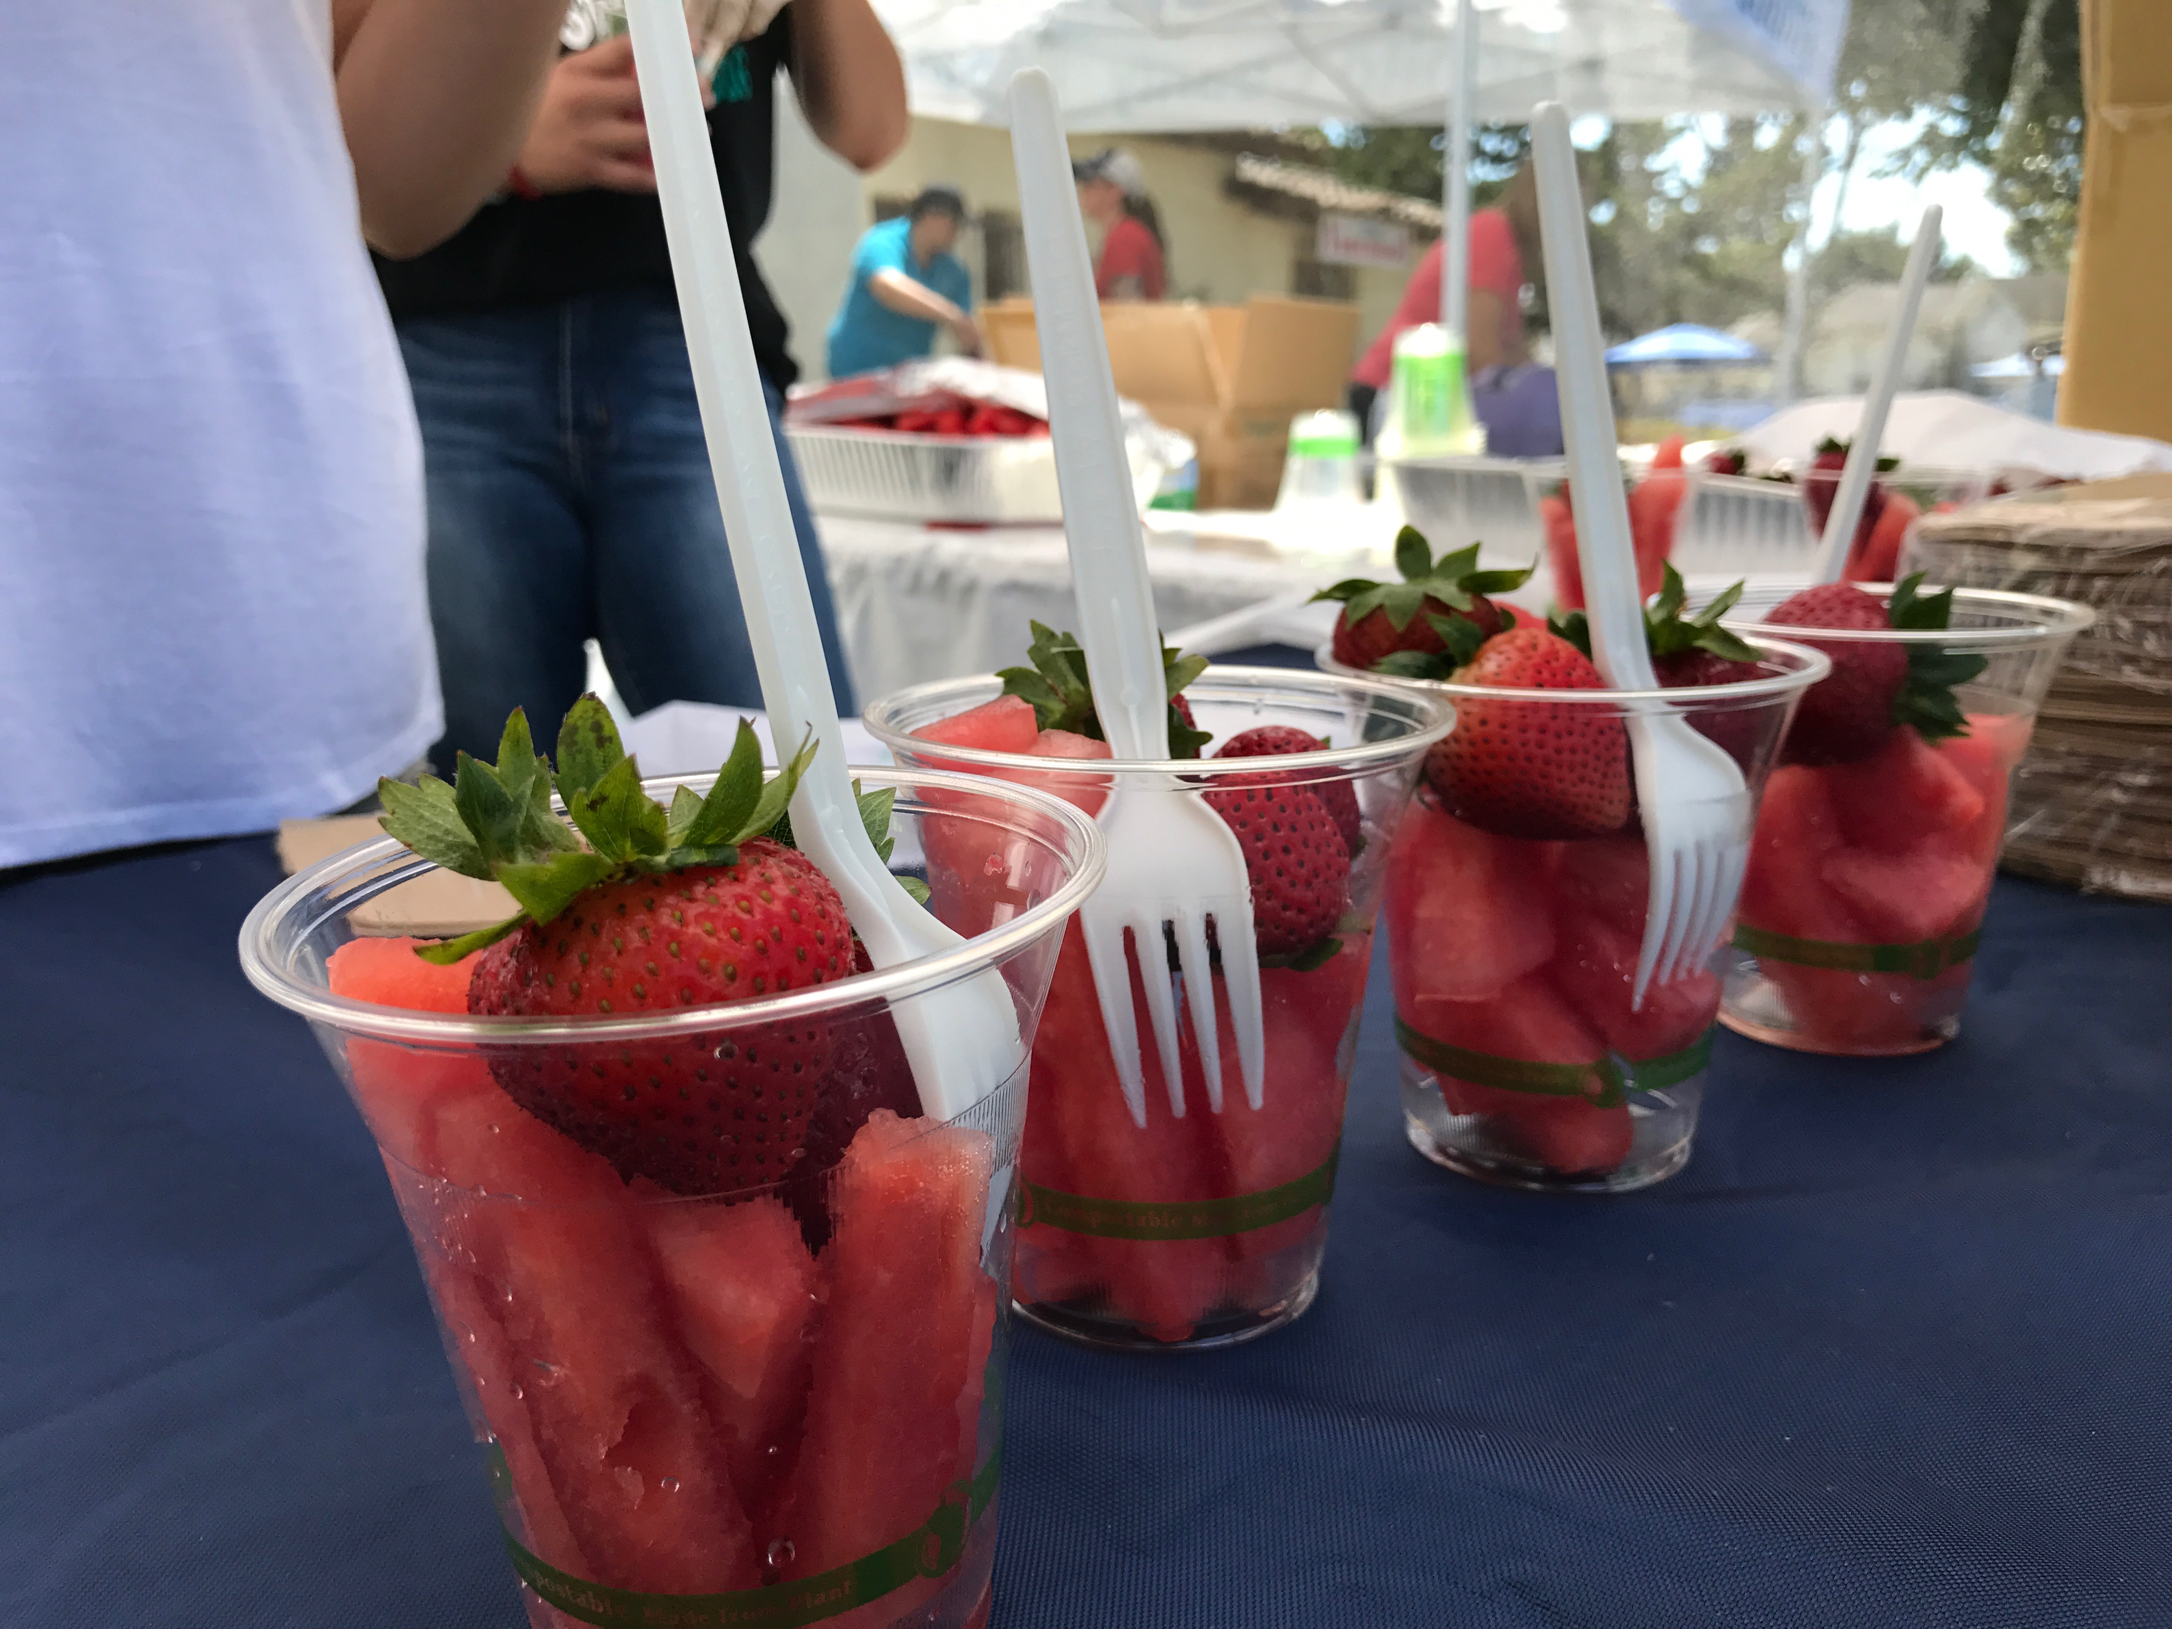

Slide 24
Thursday:
Injury and Violence Prevention
Learn about the effects of injury and violence on health

Slide 25
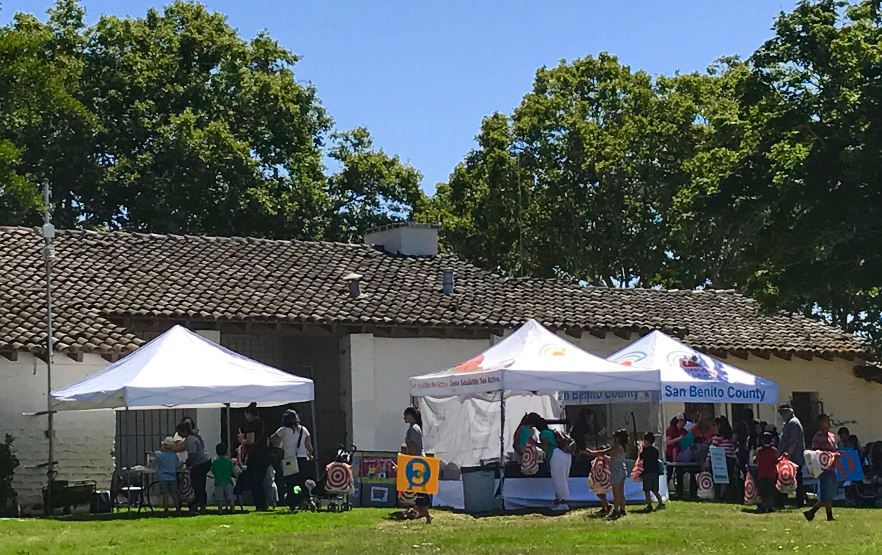
Kids at the Park

Slide 26
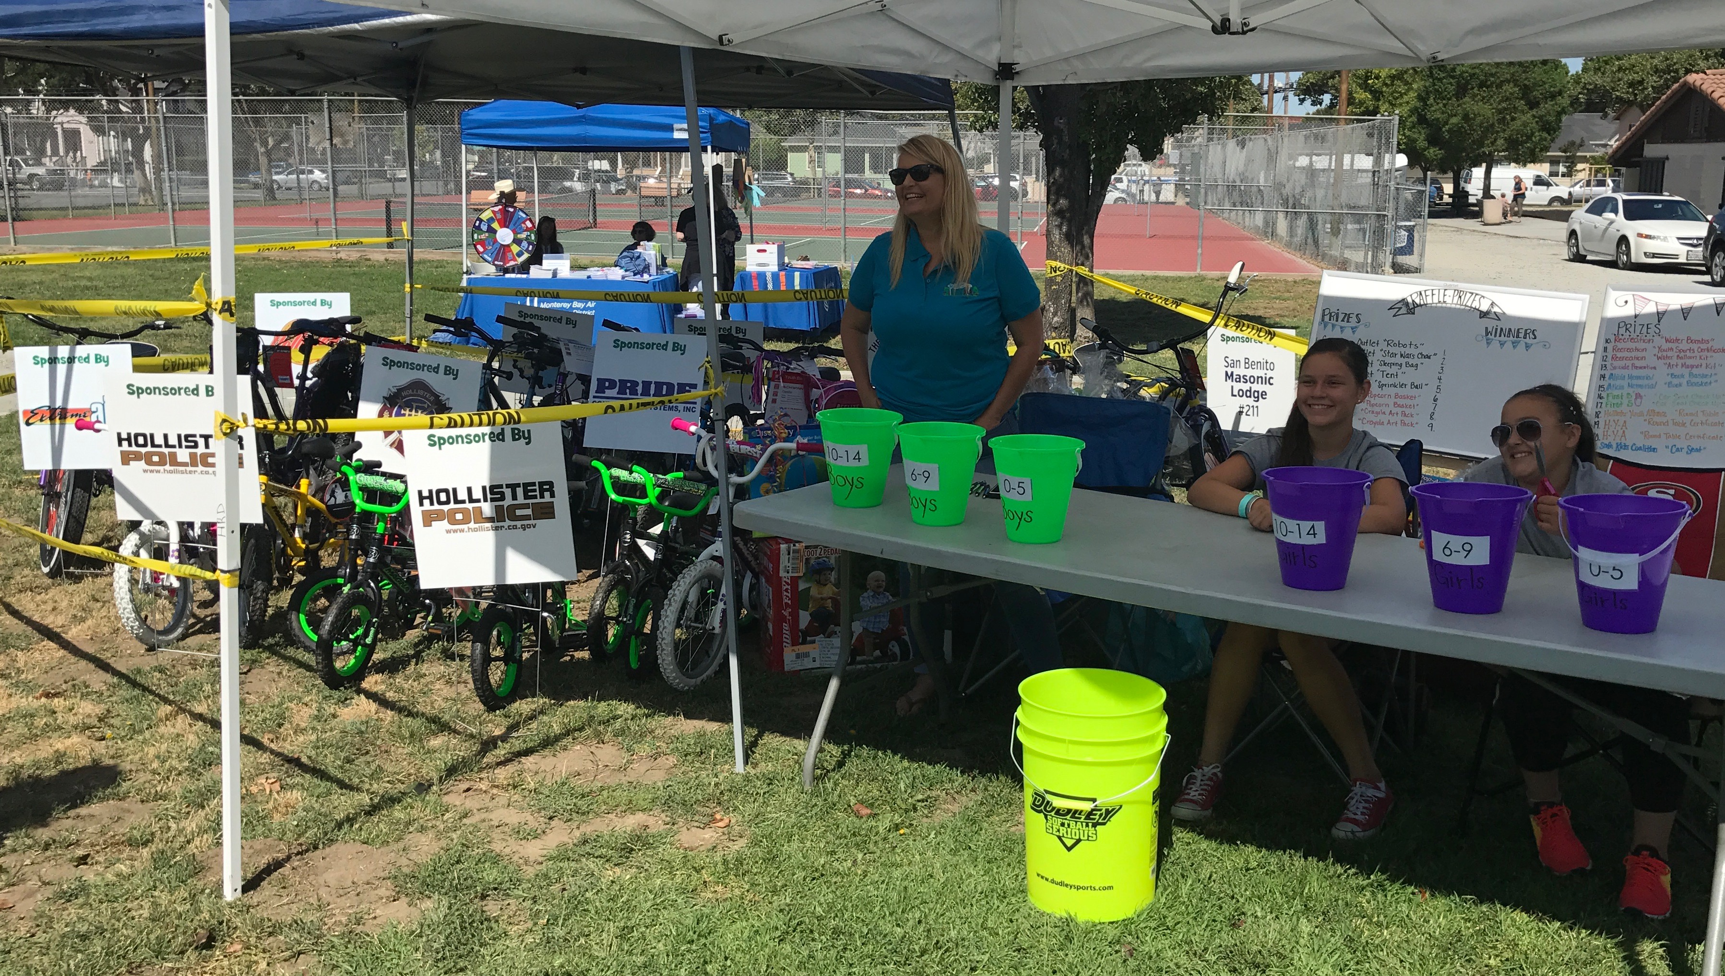

Slide 27
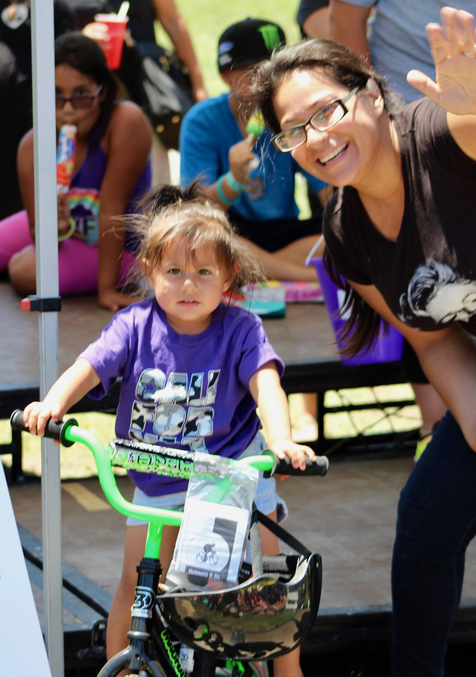
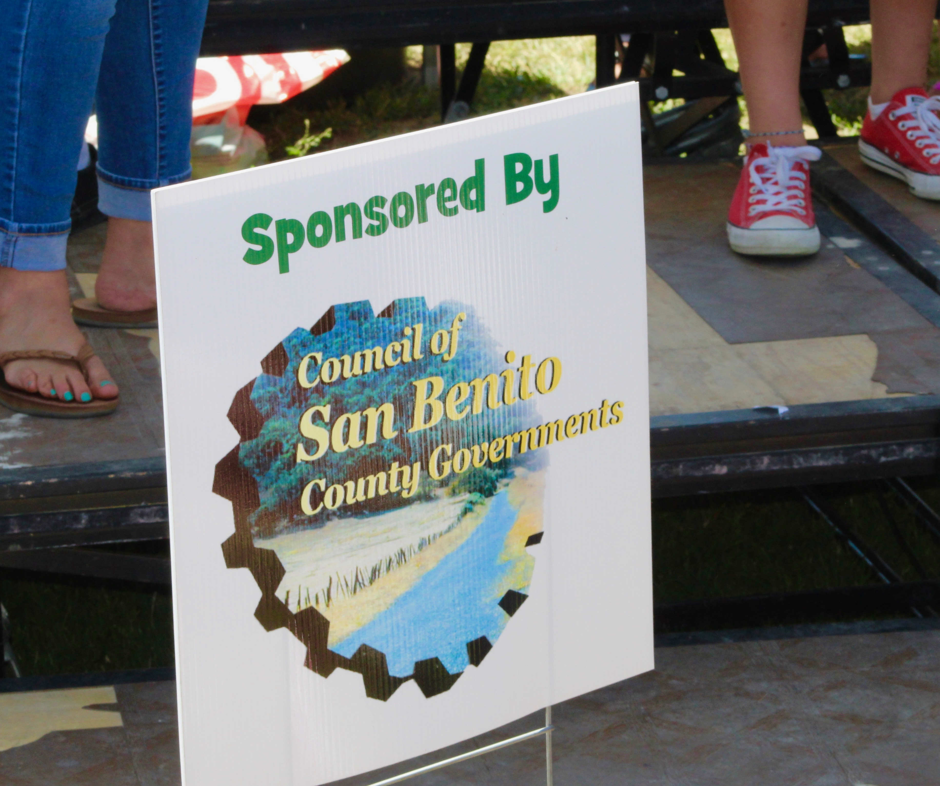

Slide 28
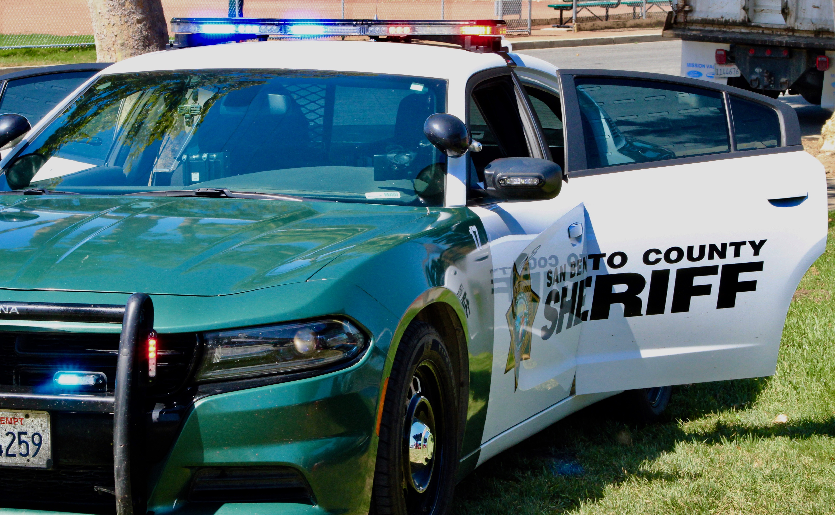

Slide 29
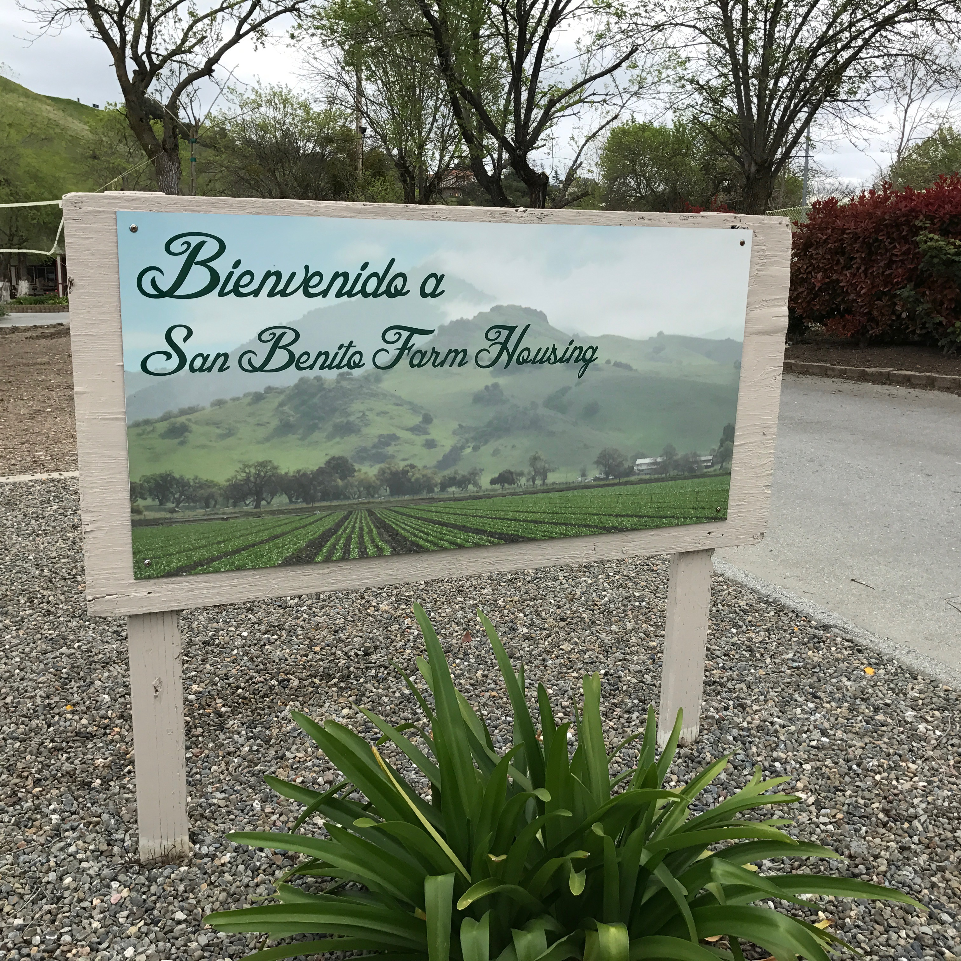
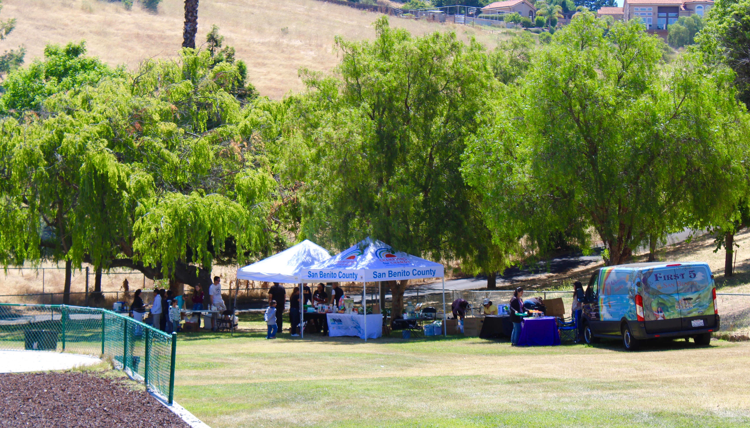
Migrant Health Fair

Slide 30
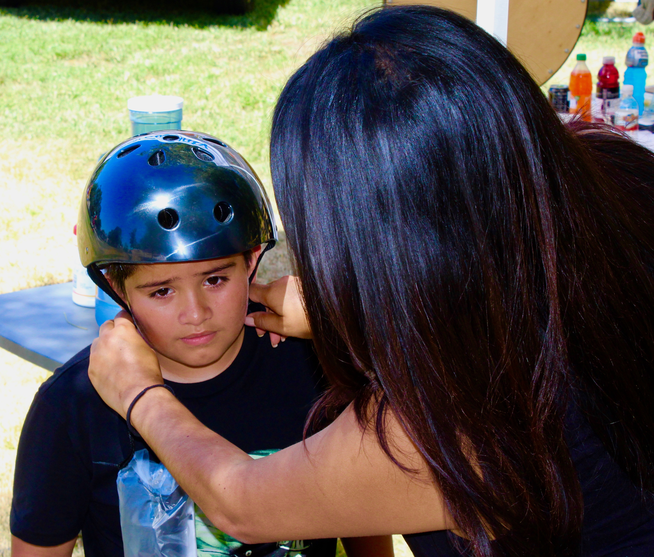
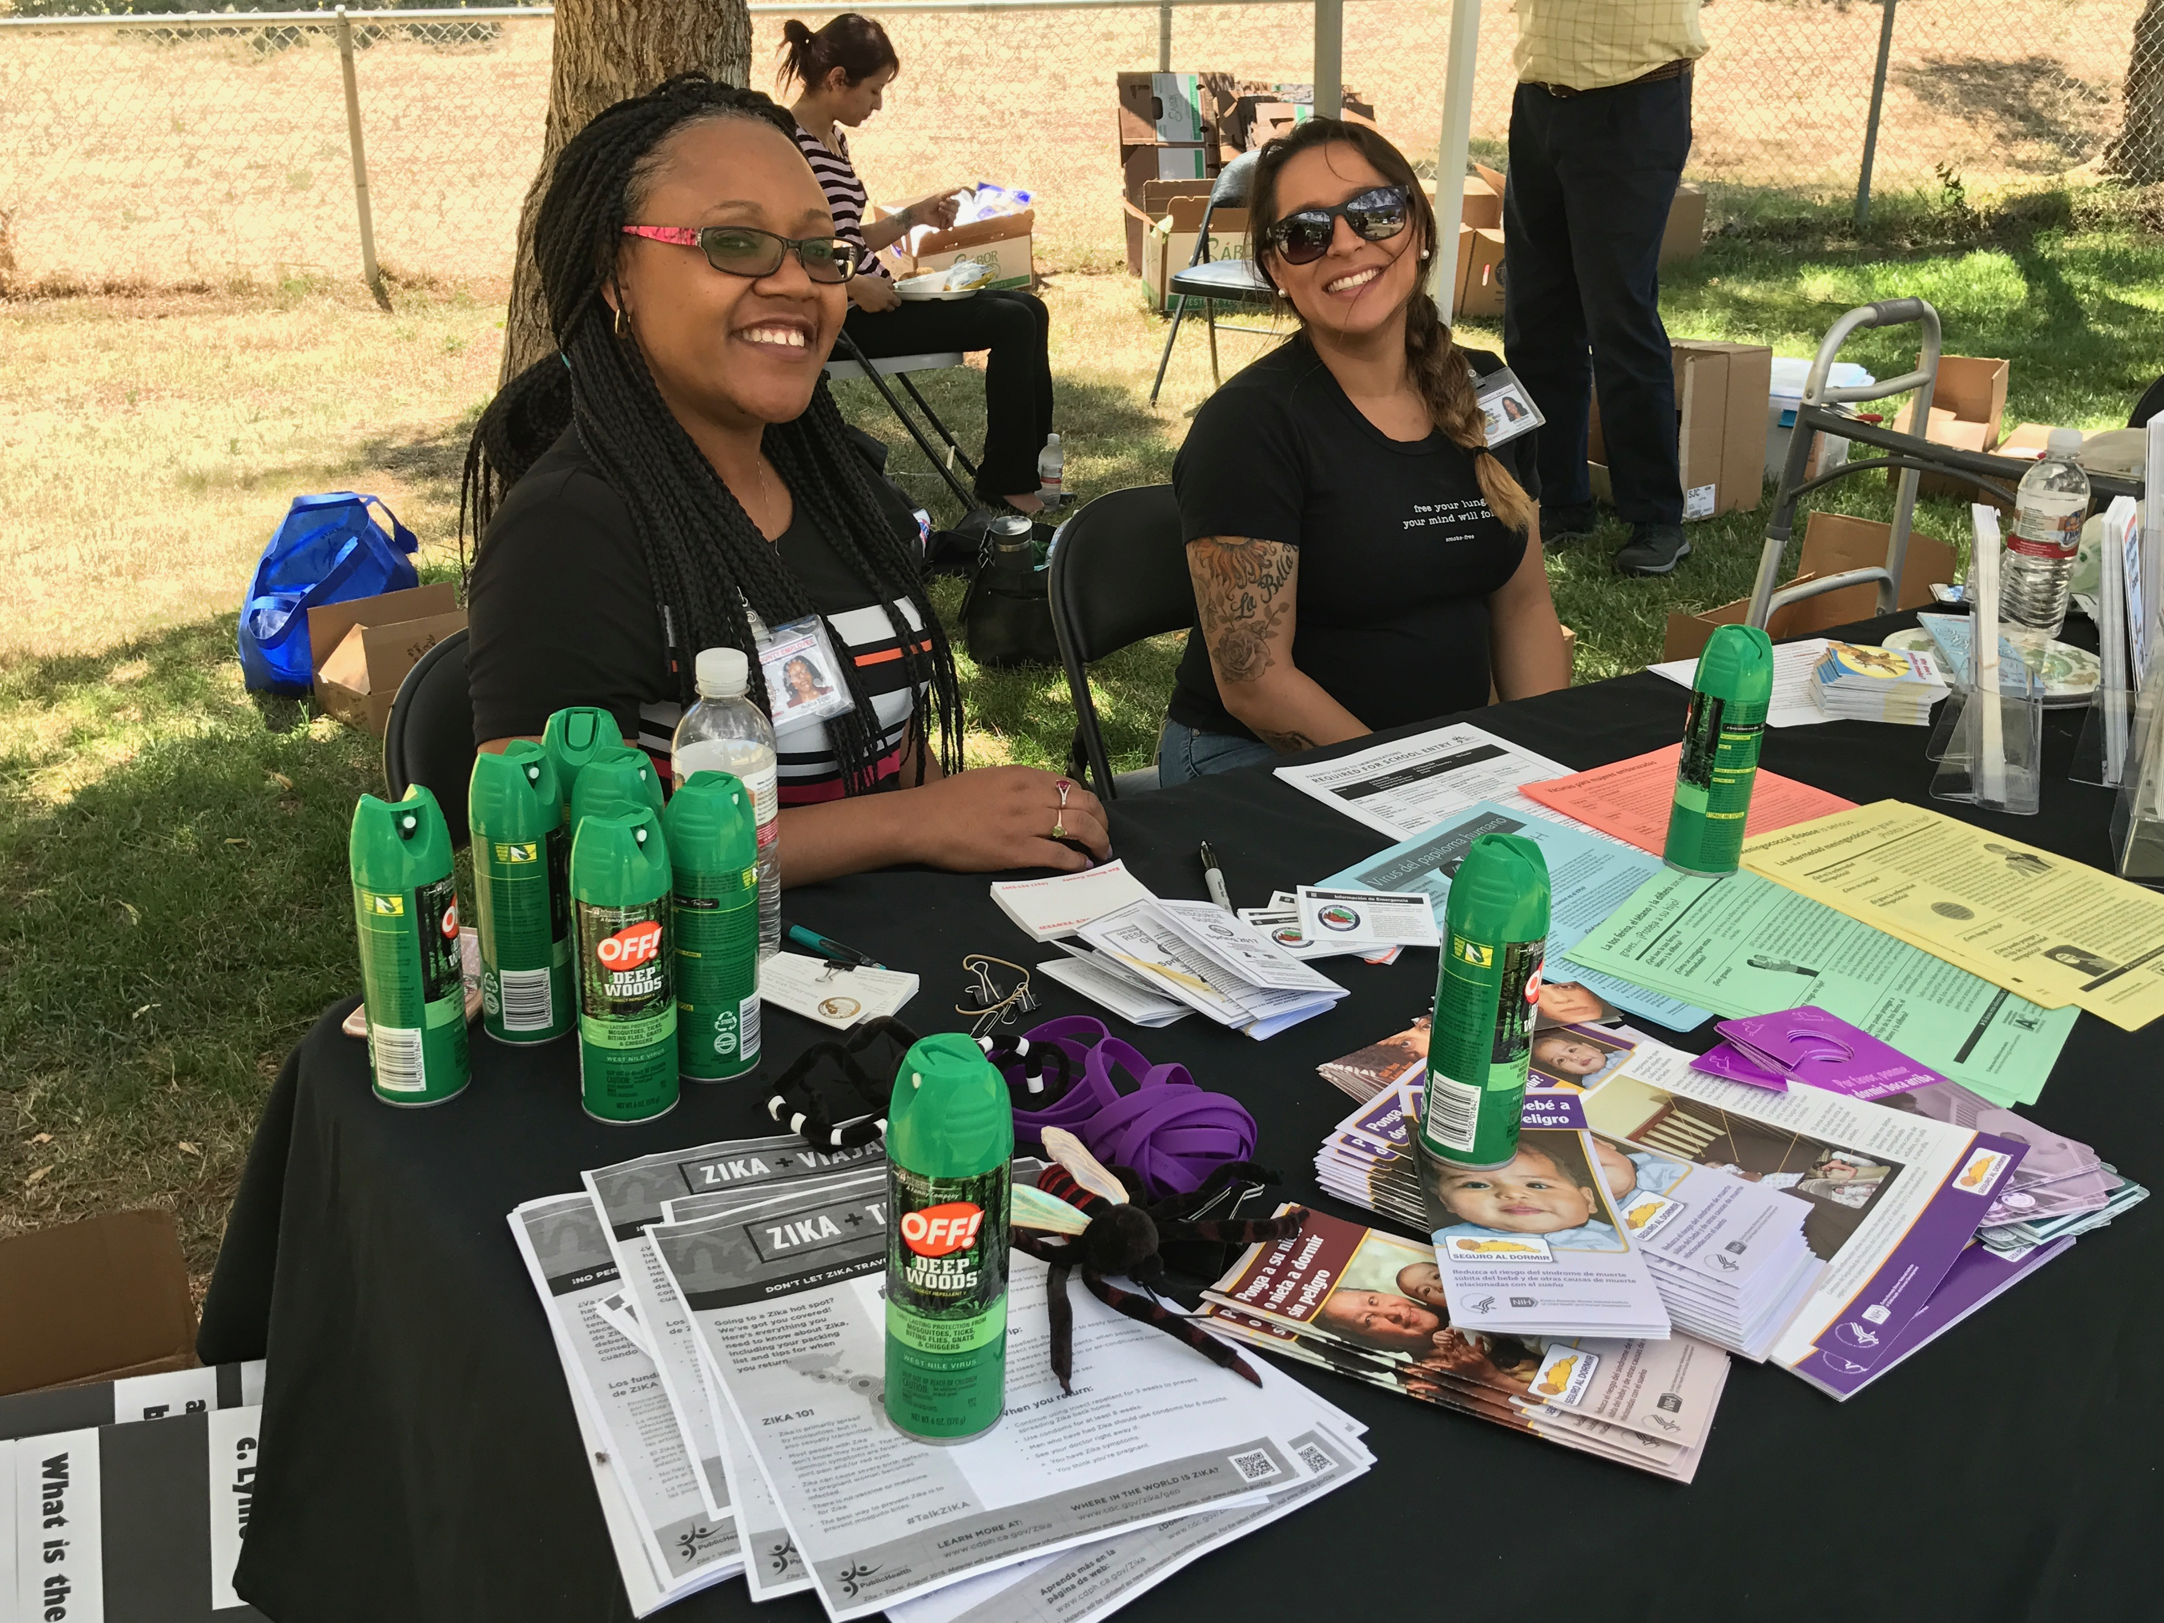

Slide 31
Friday:
Ensuring the Right to Health
Advocate for everyone’s right to a healthy life

Slide 32
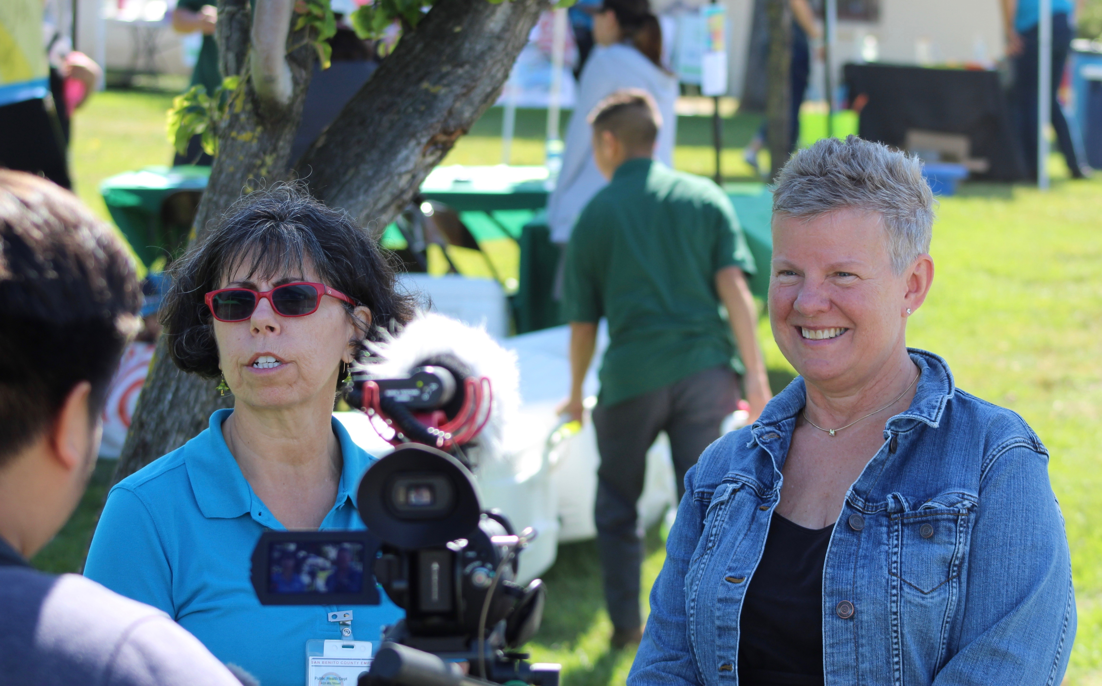
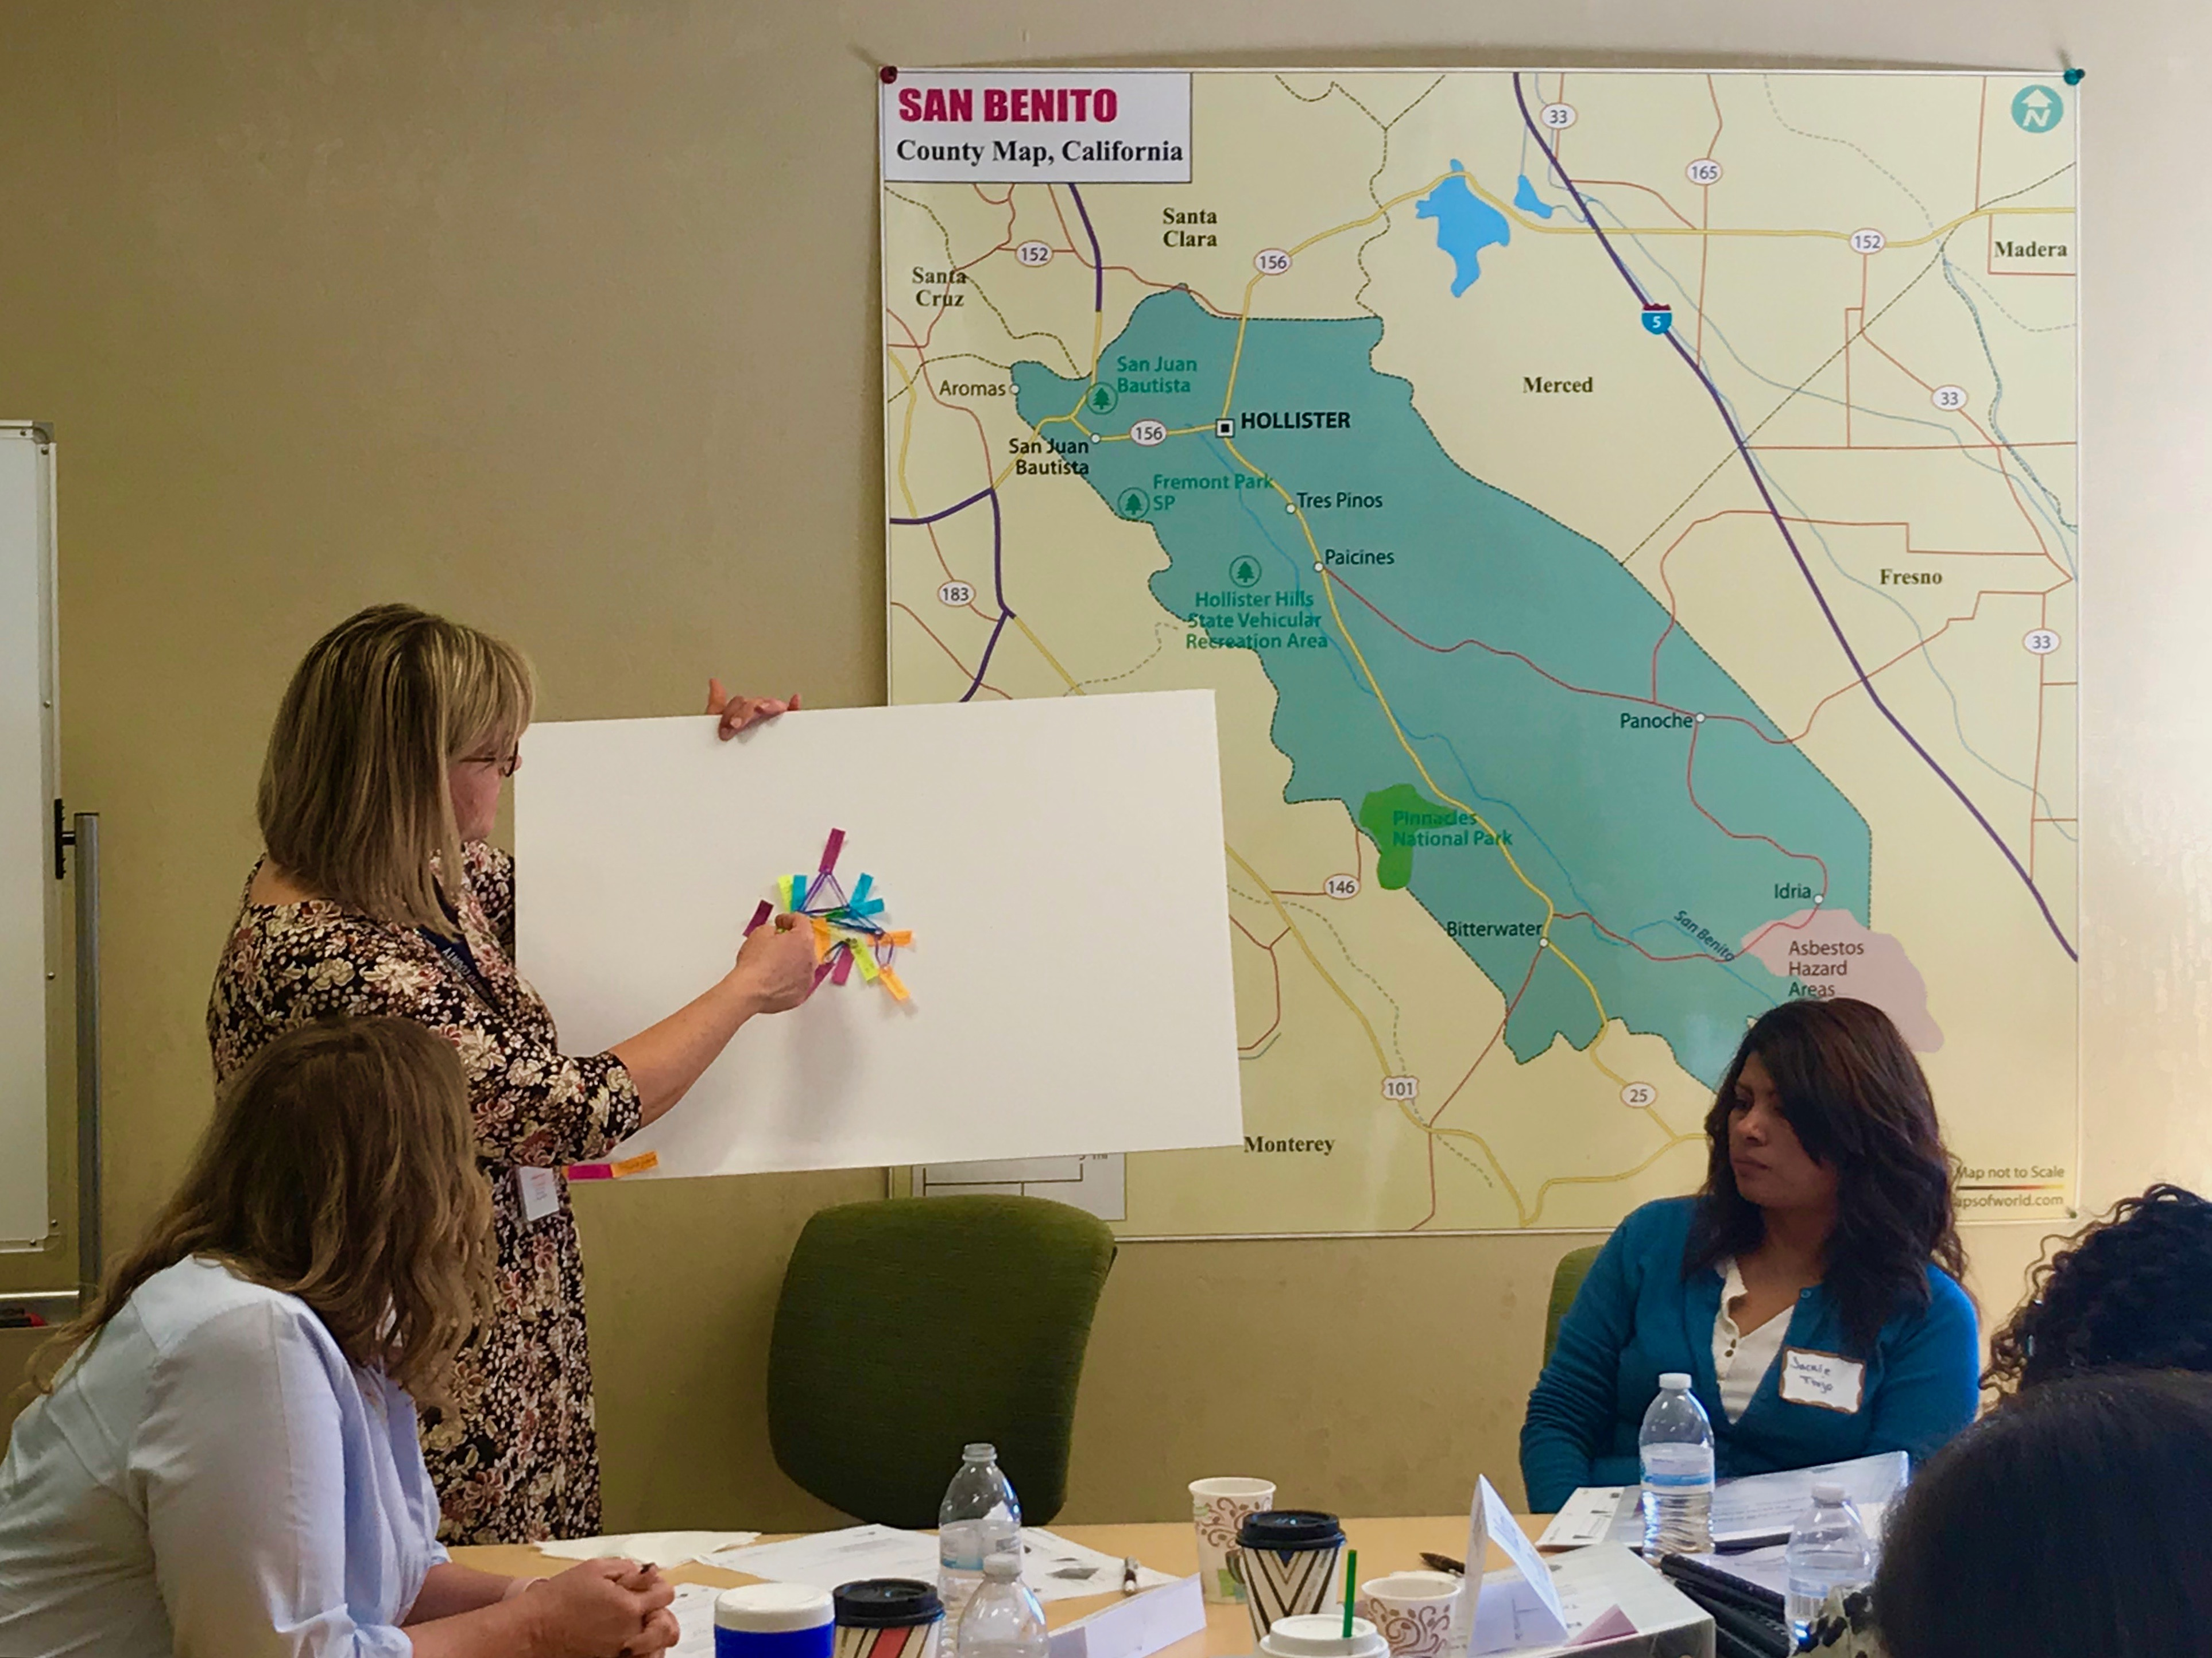
Community Partners

Slide 33
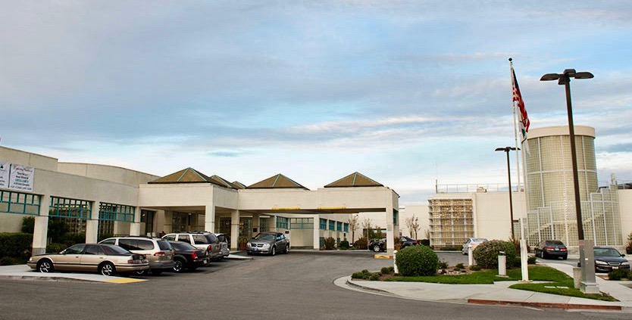
Hazel Hawkins Memorial Hospital

Slide 34
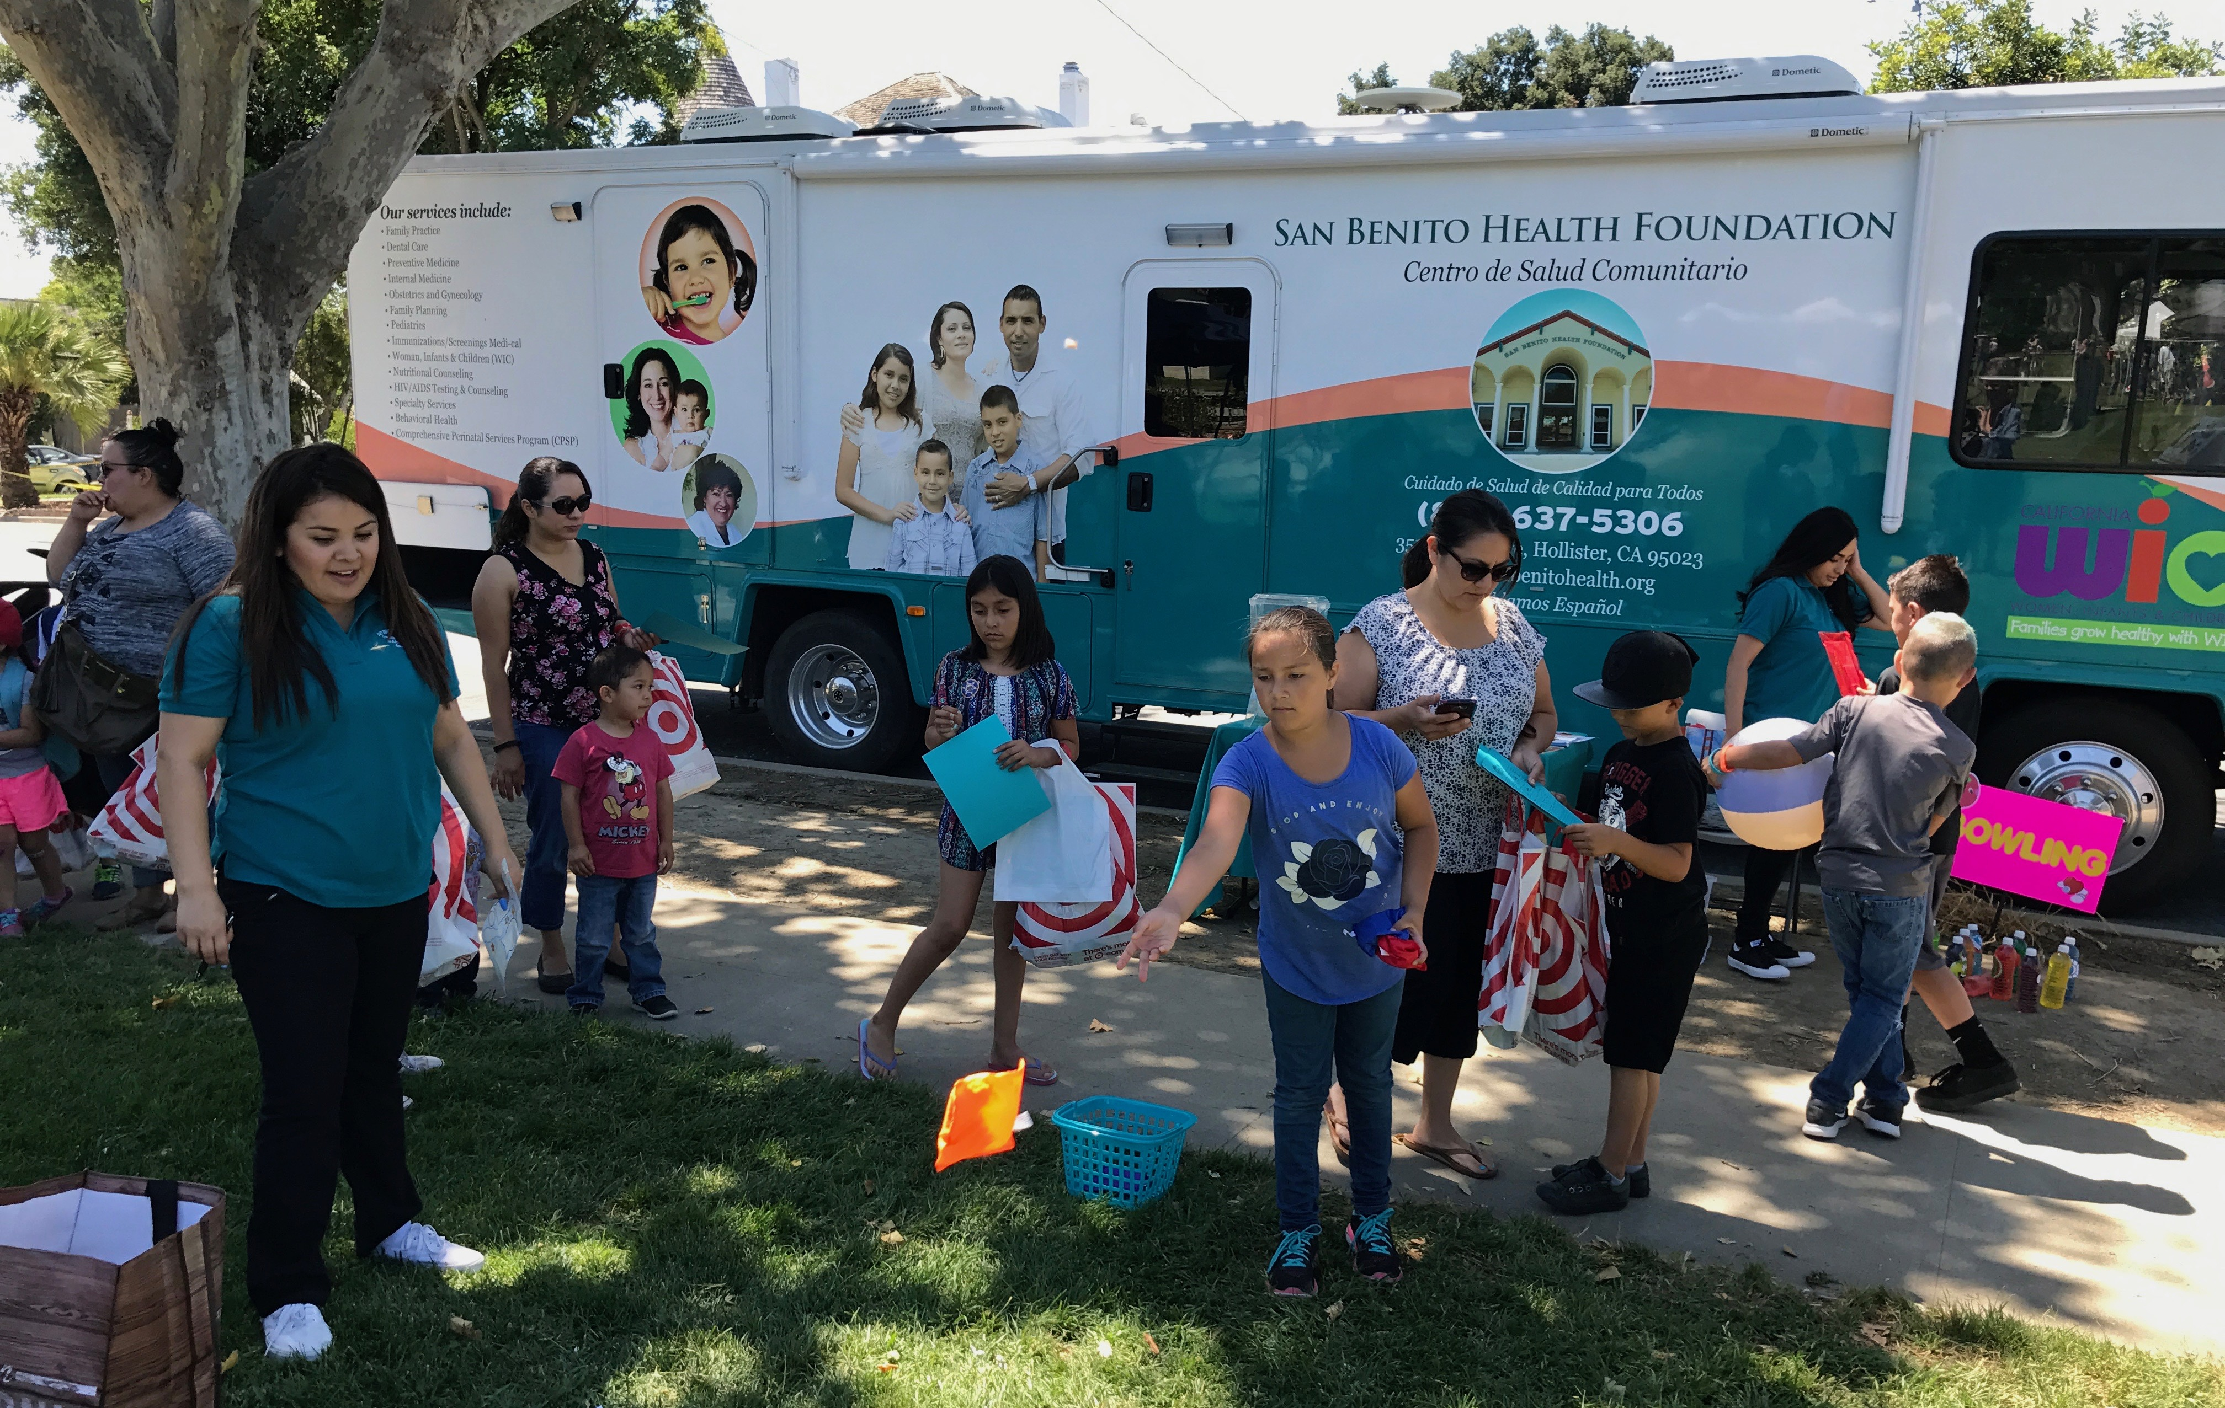
San Benito Health Foundation

Slide 35
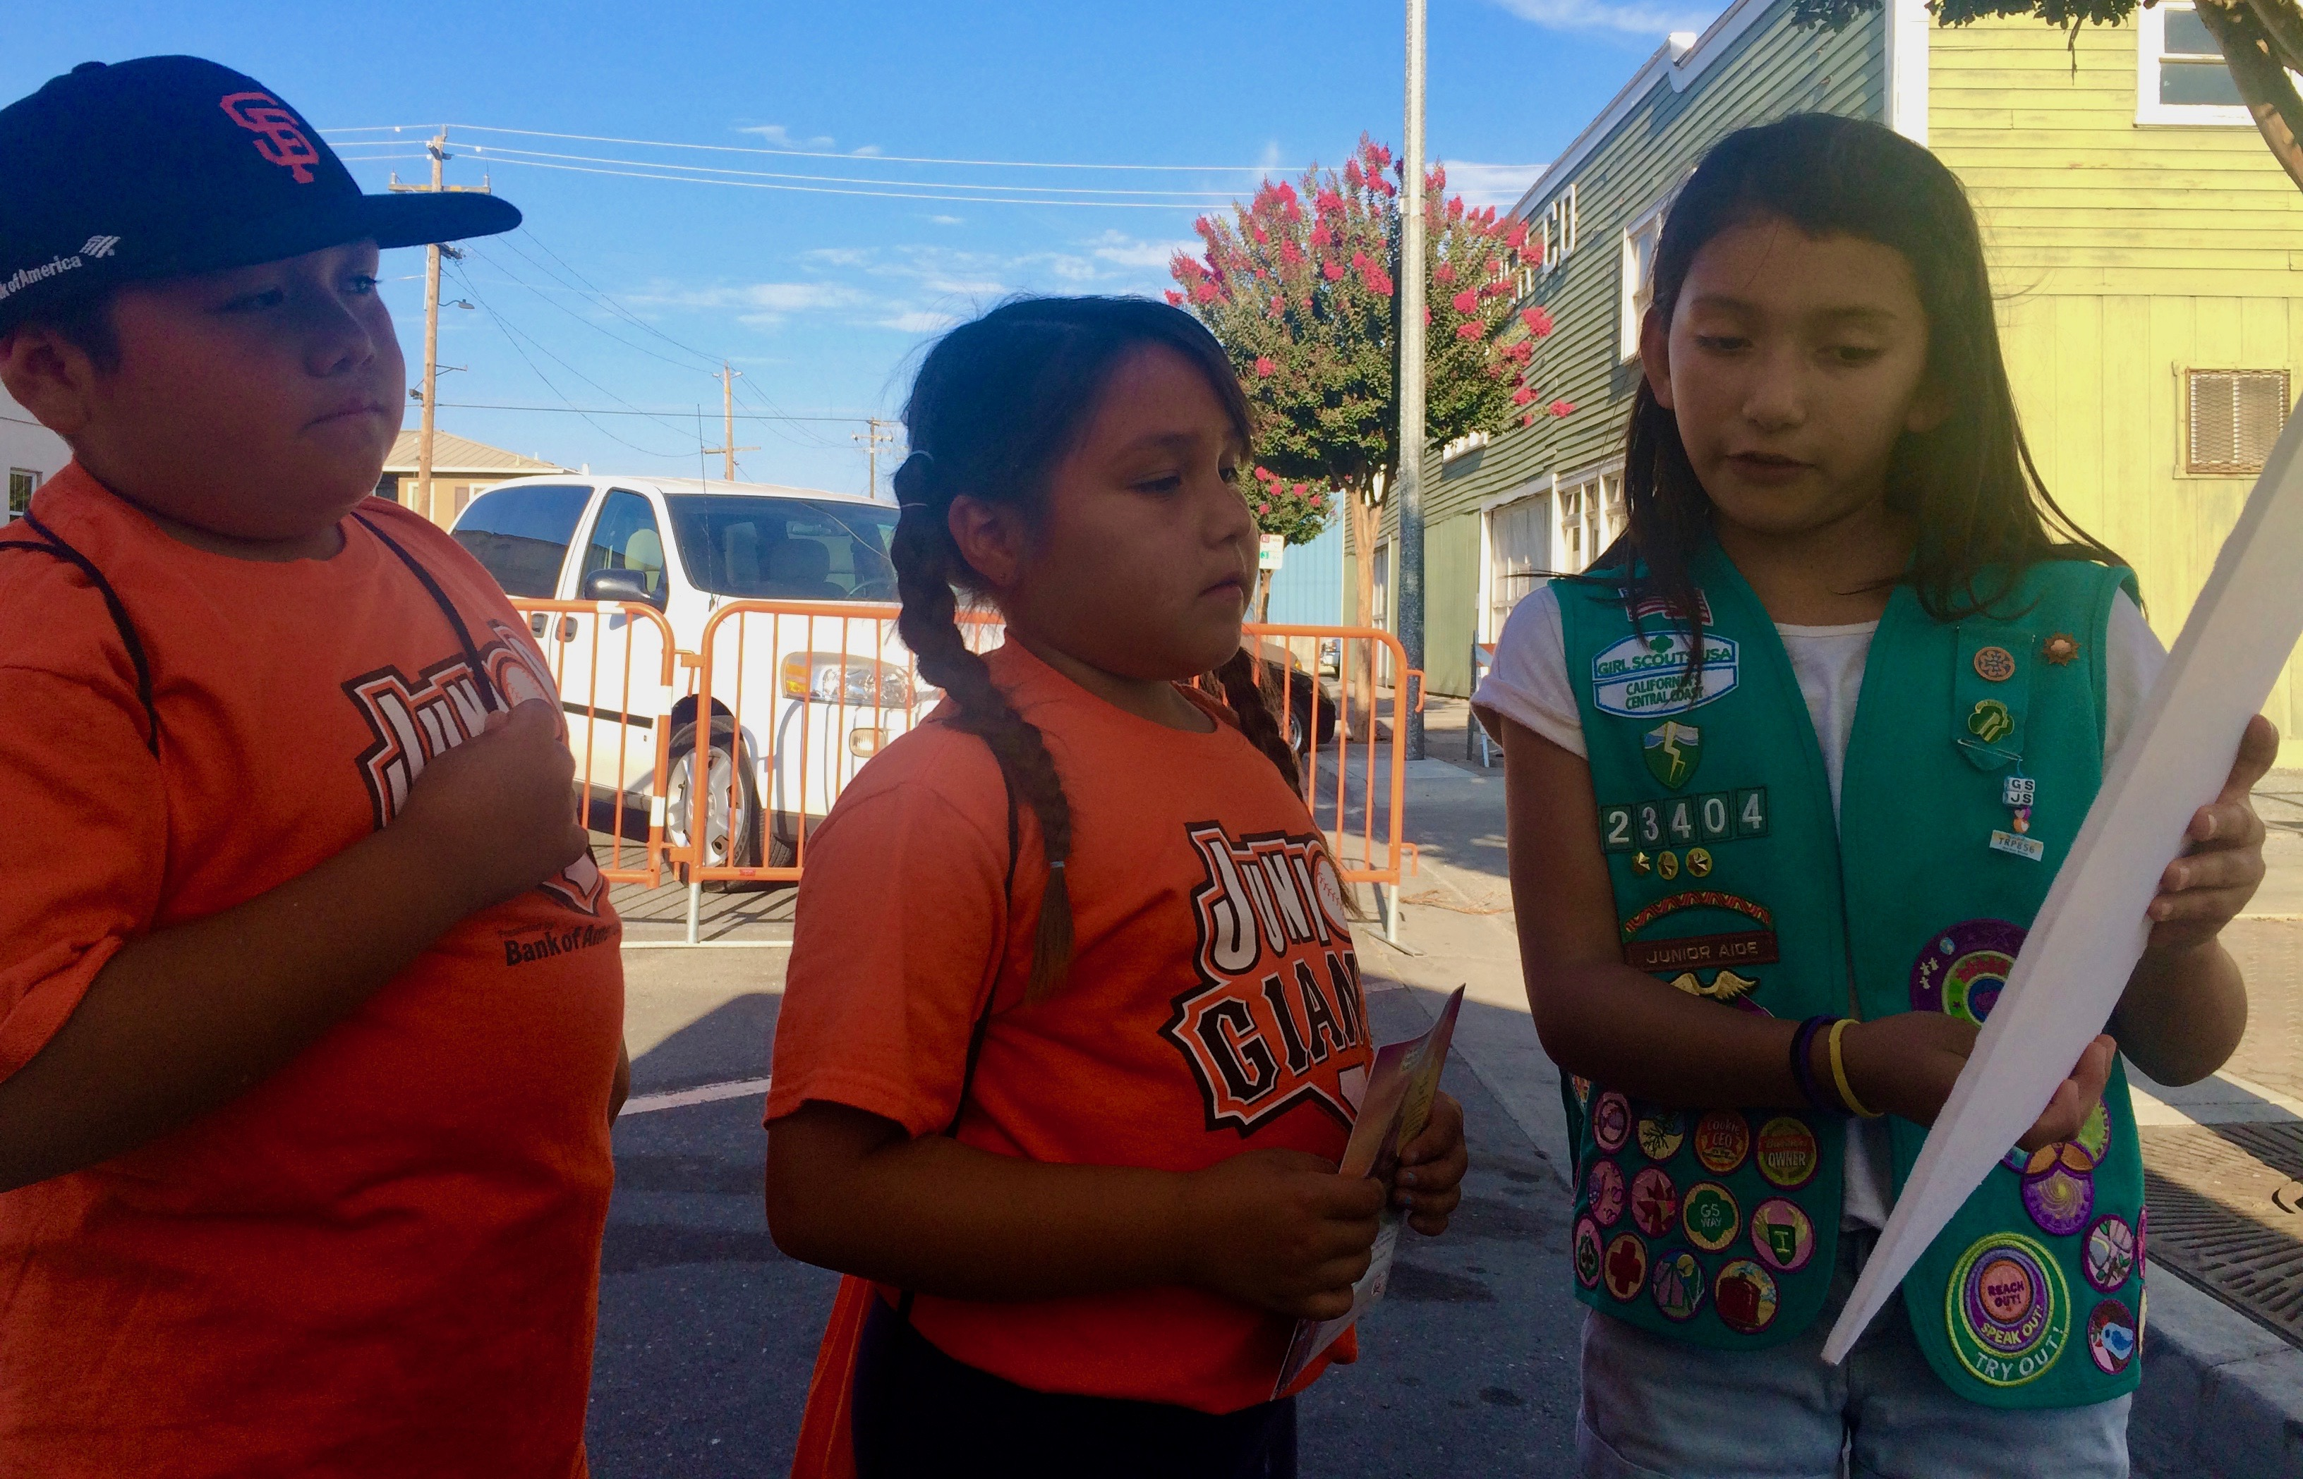
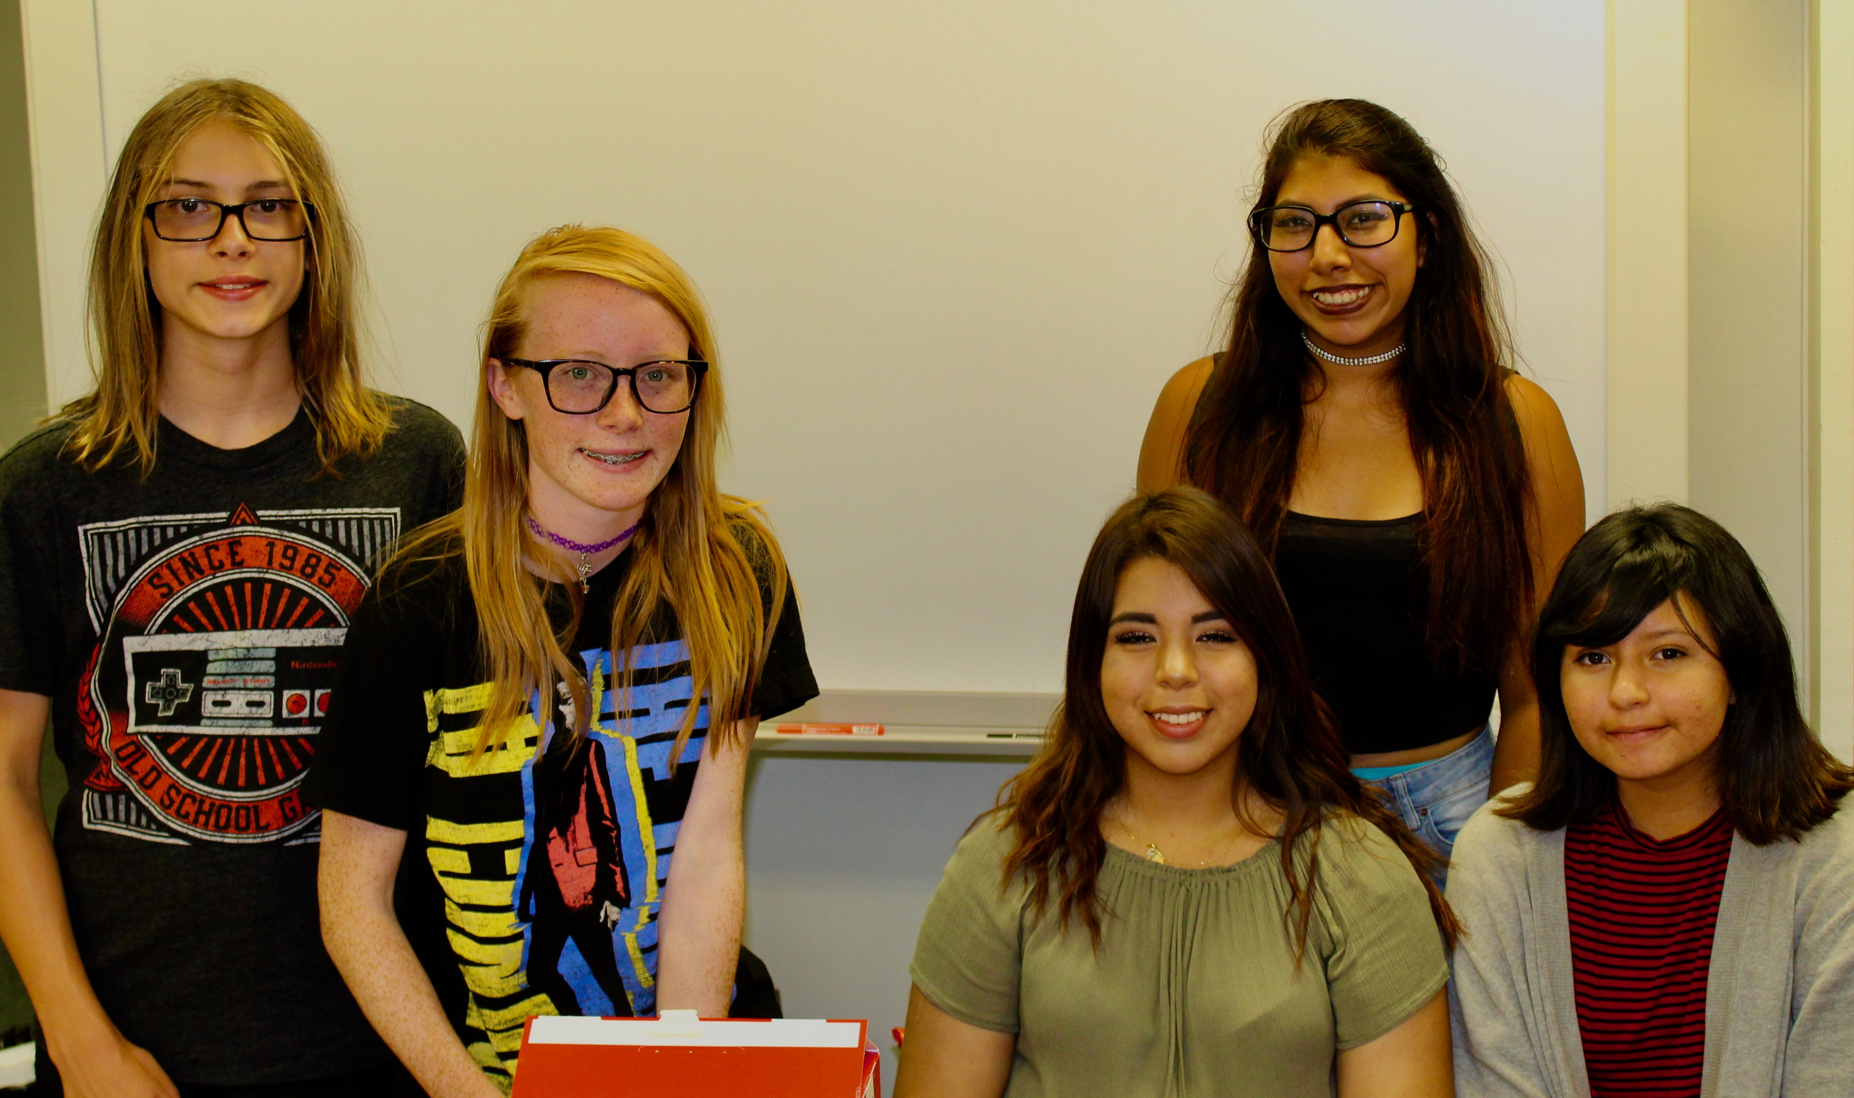
Community Advocates

Slide 36
County Health Rankings 2018

Slide 37
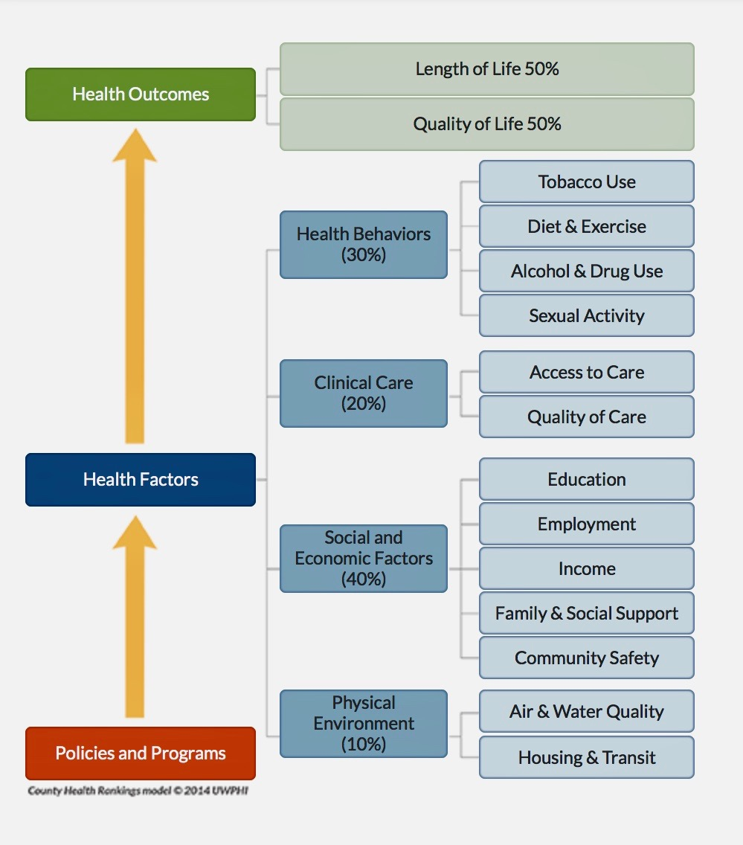
Rankings Data

Slide 38
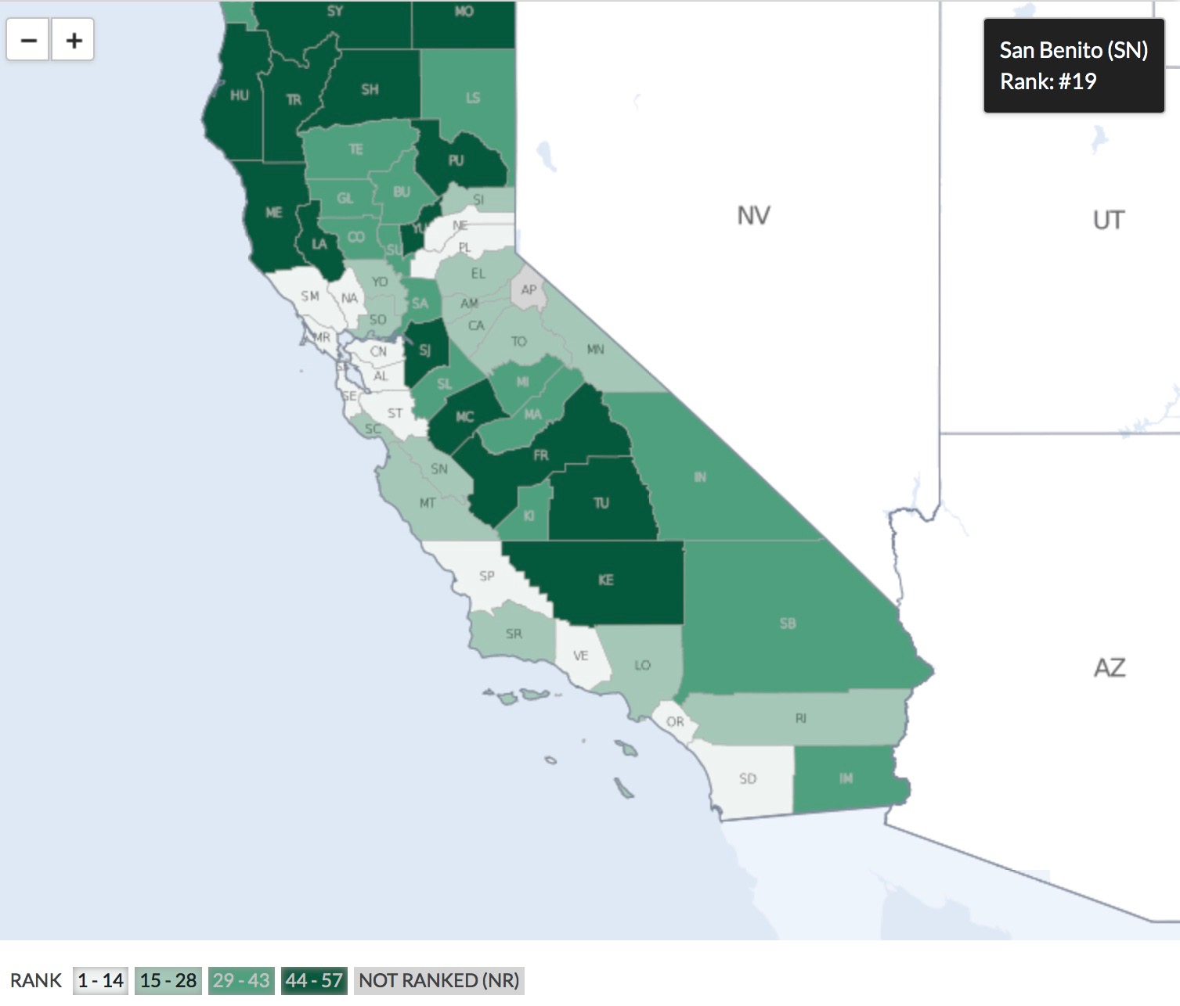
HEALTH OUTCOMES
Length of Life
Quality of Life

Slide 39
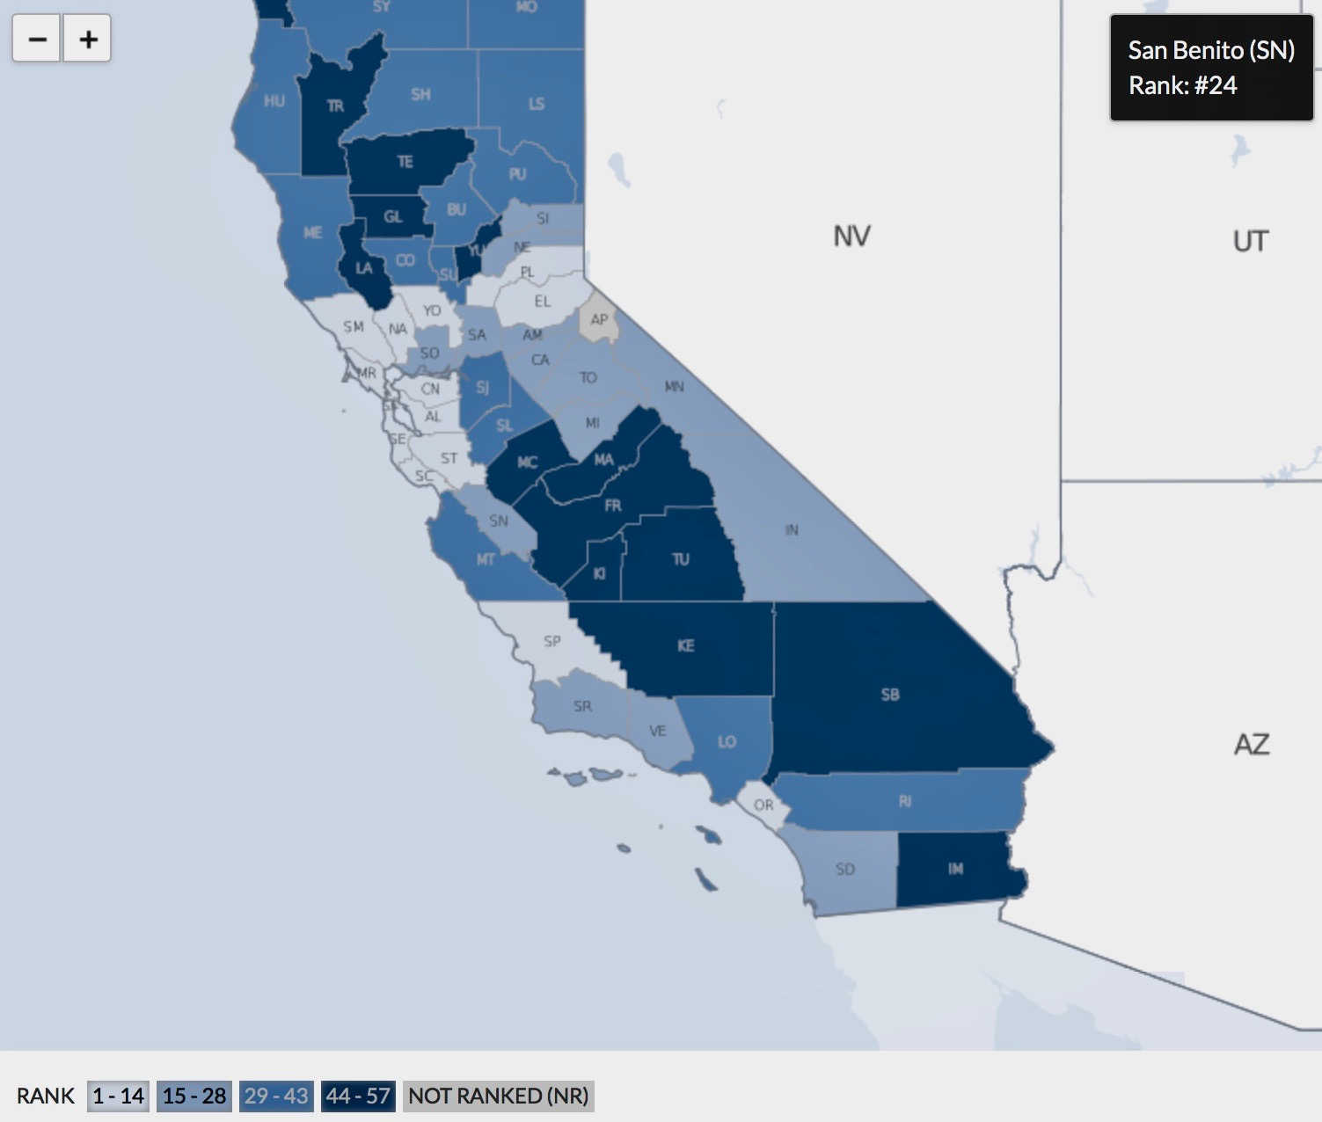
HEALTH FACTORS
Health Behaviors
Clinical Care
Social and Economic
Physical Environment

Slide 40
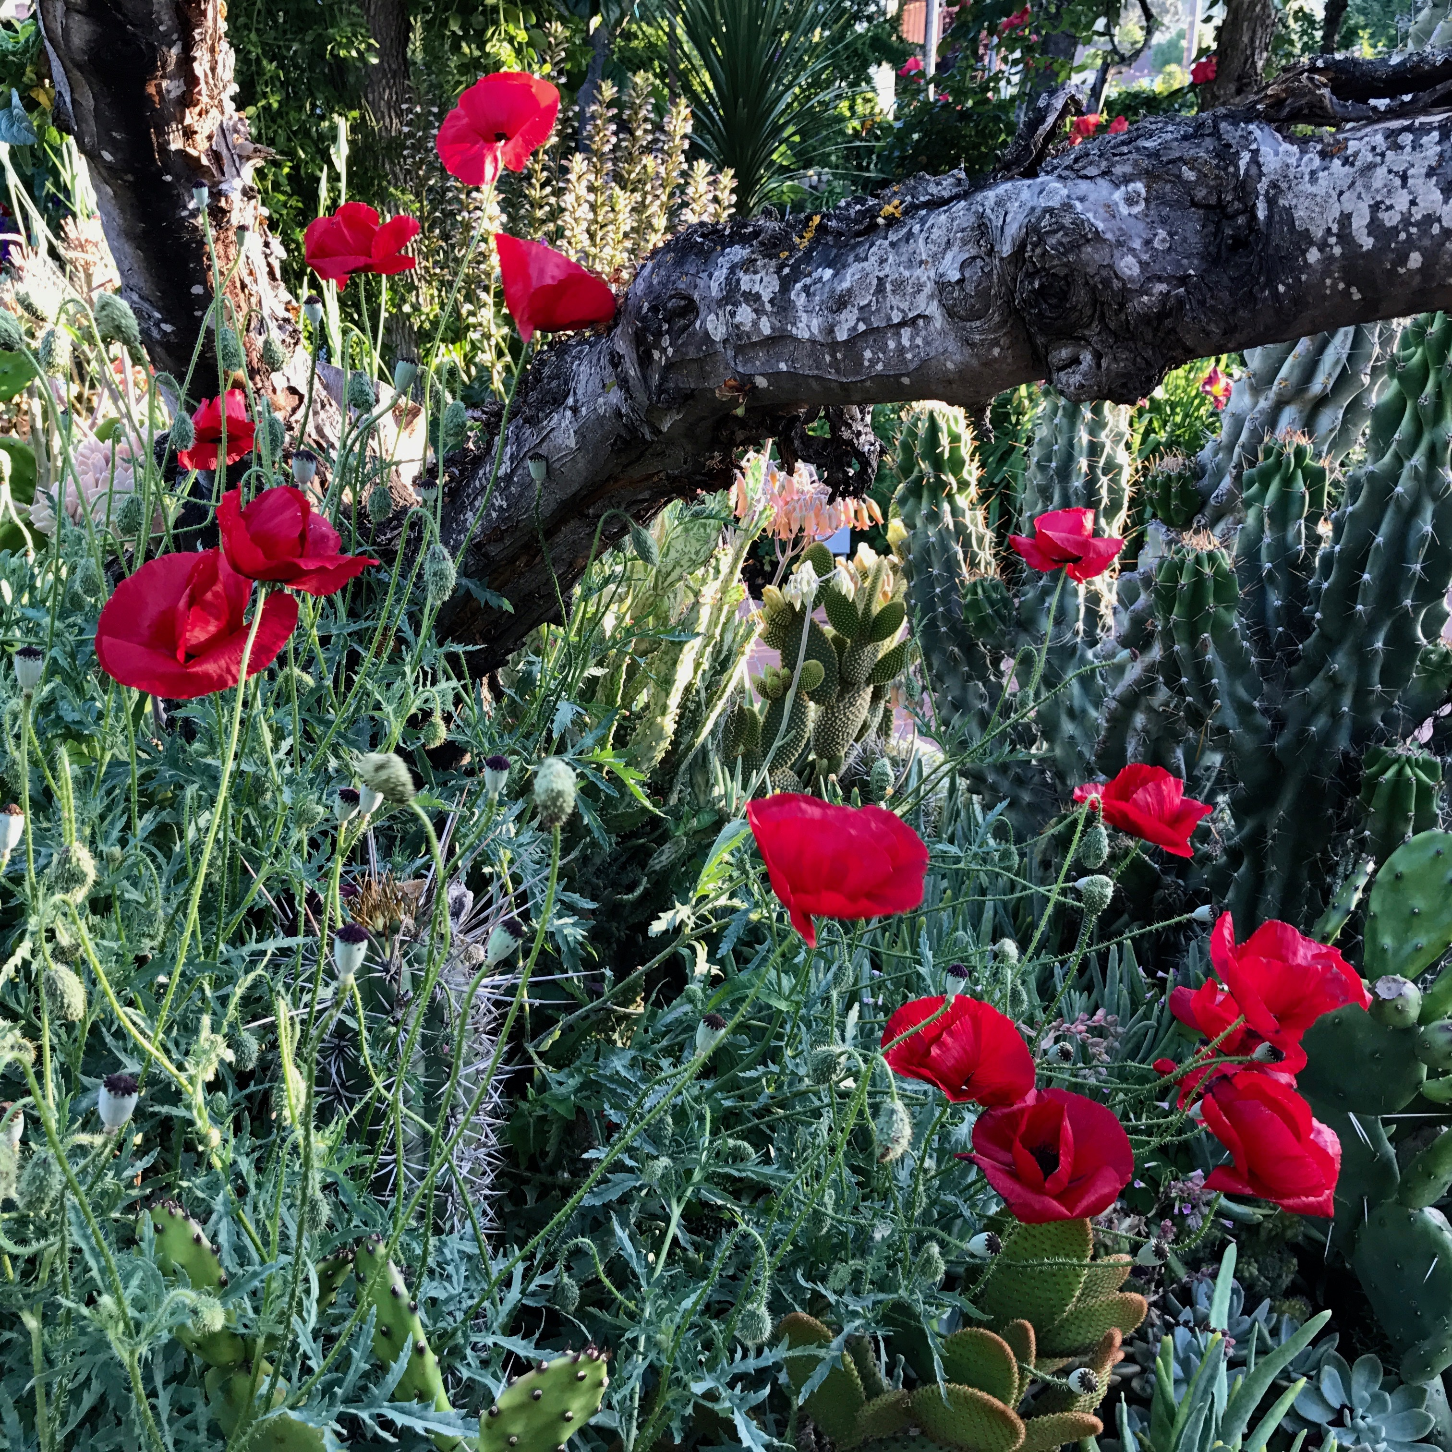
HEALTHY
SAN BENITO COUNTY
Celebrate the power of prevention
Advocate for healthy and fair policies
Build successful partnerships
Champion the role of a strong public health system

